Slide 1
World War I: 1914 - 1918
USII.5c

Slide 2
Allied Forces & Central Powers

Slide 3
Introduction: Key Terms to Know
NOTES:

Slide 4
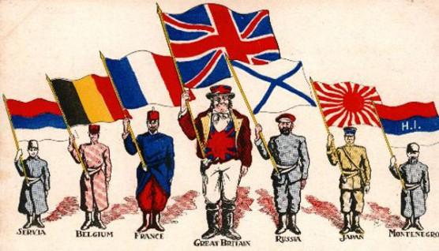
Causes of WWI Nationalism
A feeling of intense pride and loyalty to one’s country… led to much of the tension in Europe!

Slide 5
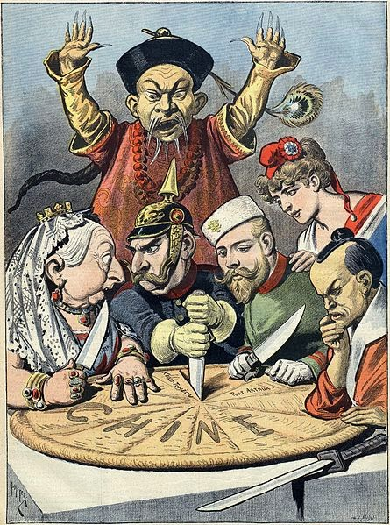
Causes of WWI Imperialism
European nations wanted to expand their empires by taking over other countries for their economic/political gain.
Great Britain and France already had large overseas empires but they wanted more!
Plus, Germany, Italy, and Russia also wanted to expand!
Imperialism = A policy of extending your rule over foreign countries.

Slide 6
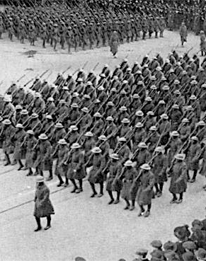
Causes of WWI Militarism
As European nations competed for colonies, they made their armies and navies stronger in order to protect their interests.
So, as soon as one country increased its army & navy, then another country would increase their military too!
Militarism = buildup of strong military forces within a country, usually in preparation for war.

Slide 7
Militarism…cont.
Germany, France, and Russia developed huge armies in the early 1900s!
Great Britain had the world’s largest & strongest navy… a bitter rivalry broke out when Germany tried to challenge their power!

Slide 8
Causes of WWI Alliances
“The Chain of Friendship”
European countries had made defense agreements between nations to aid and protect one another.
"If Austria attacks Serbia, Russia will fall upon Austria, Germany upon Russia, and France and England upon Germany."

Slide 9
Causes of WWI Assassination of Archduke Franz Ferdinand:
Heir to the Austro-Hungarian Empire
He and his wife were shot and killed in June, 1914
His assassin was a member of a Serbian nationalist group; the assassination destroyed the delicate balance of stability in Europe
Due to the alliance system, when Austria-Hungary declared war on Serbia, Germany joined them!

Slide 10
Alliances: Everyone Declares War!
Russia then came to the aide of Serbia
August, 1914 = Germany declared war on Russia
Knowing that France was an ally of Russia, Germany declared war on France.
A day later, Germany invaded Belgium.
Since Great Britain was Belgium’s ally, Britain declared war on Germany.
THE GREAT WAR WAS ON!!!!

Slide 11
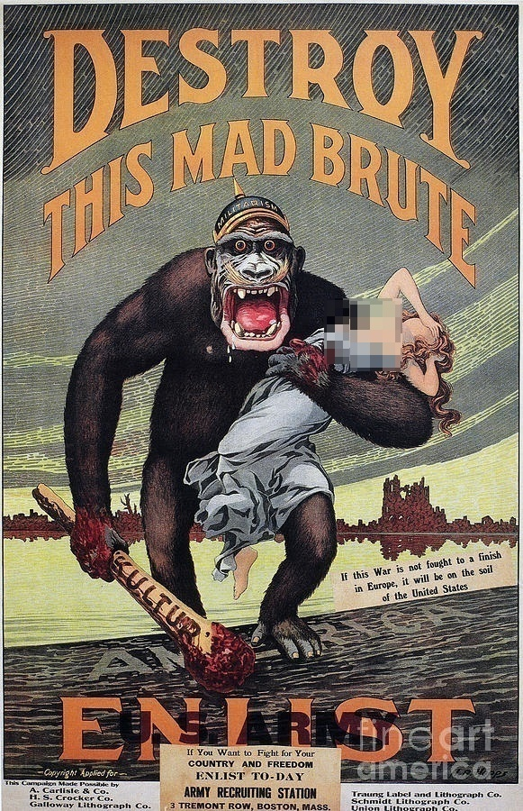
A. Reasons for the United States Involvement in World War I
NOTES
America’s inability to remain neutral
The U.S. joined the Allies and entered the war on April 6, 1917

Slide 12
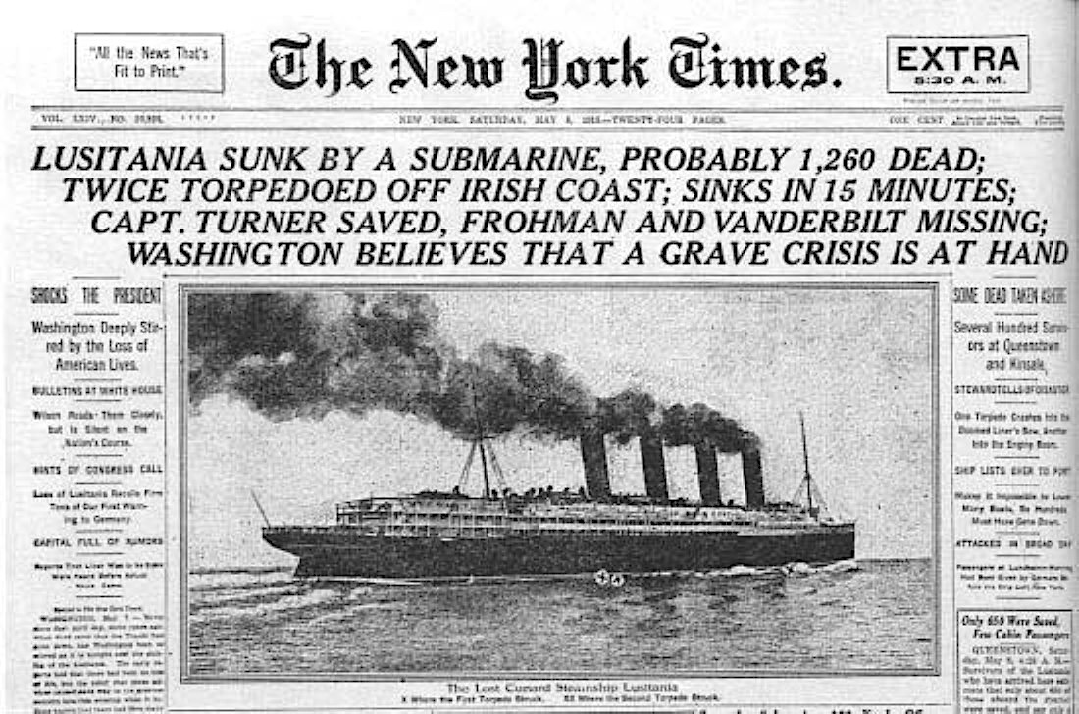
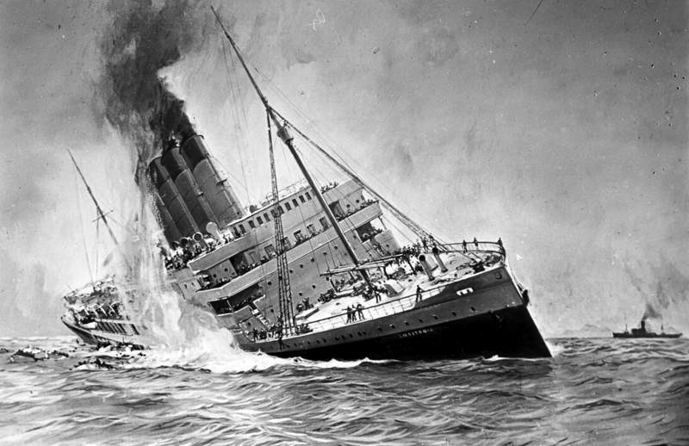
A. Reasons for the United States Involvement in World War I
NOTES
2. German Submarine Warfare:
The Germans wanted to prevent supplies from reaching Allied nations, specifically Great Britain, so they would shoot down any ship without warning.
On May 7, 1915, the sinking of the British ocean liner RMS Lusitania

Slide 13
A. Reasons for the United States Involvement in World War I
NOTES
3. The United State’s economic and political ties with Great Britain

Slide 14
A. Reasons for the United States Involvement in World War I
NOTES
4. Germany tries to persuade Mexico to declare war on the United States with the Zimmerman Telegram.
In return, Germany promised to help Mexico win back the lands lost to the U.S. during the War with Mexico.

Slide 17
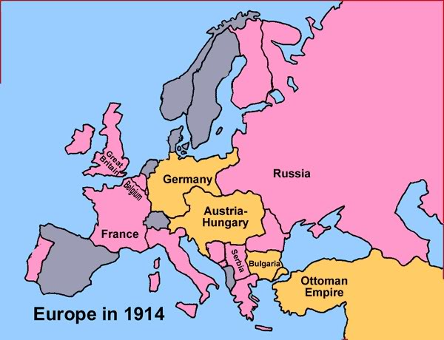
B. The Allied Powers:
The British Empire*
France*
Russia*
Serbia
Belgium
The United States
*The Triple Entente

Slide 18
B. The Central Powers:
Also known as “The Triple Alliance”
German Empire
Austro-Hungarian Empire
Bulgaria
Ottoman Empire (Turkish)

Slide 19
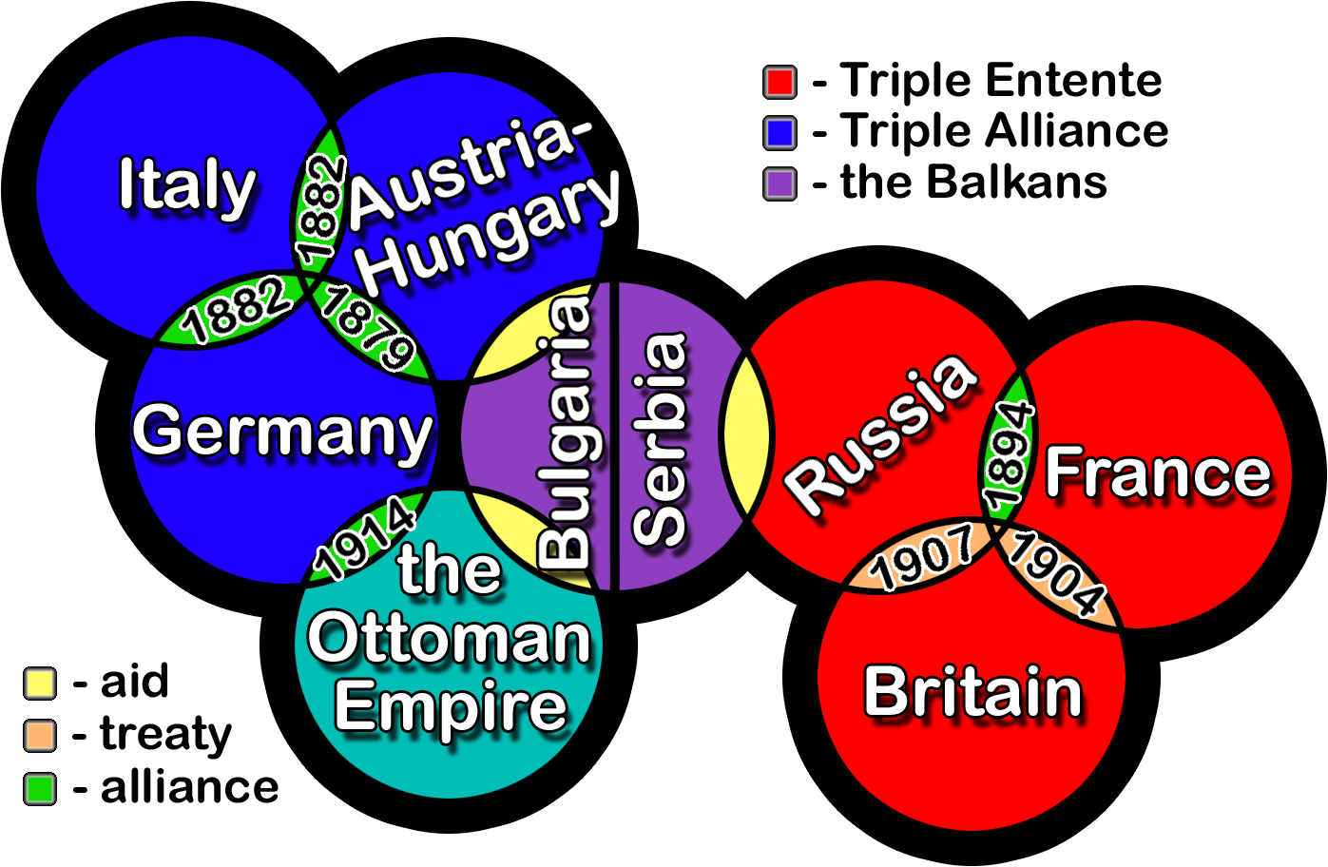
(The Allied Powers)
(The Central Powers)

Slide 20
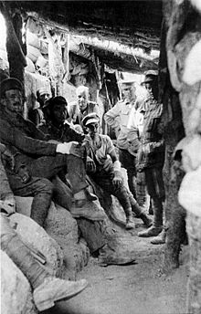
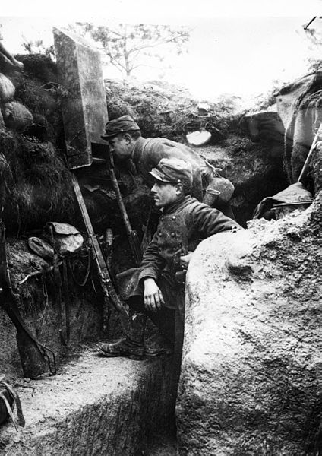
Trench Warfare
For three years, Allies and Central Powers faced each other across a network of trenches.
Trenches along the front lines protected soldiers from bullets; trenches behind the lines served as headquarters, first-aid stations, and storage areas.

Slide 21
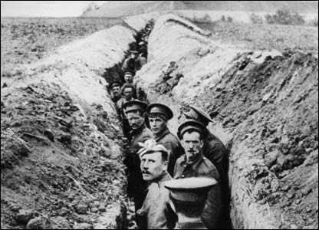
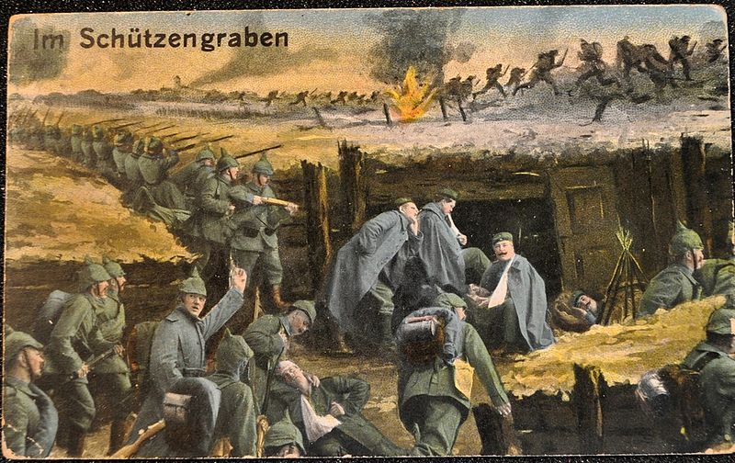
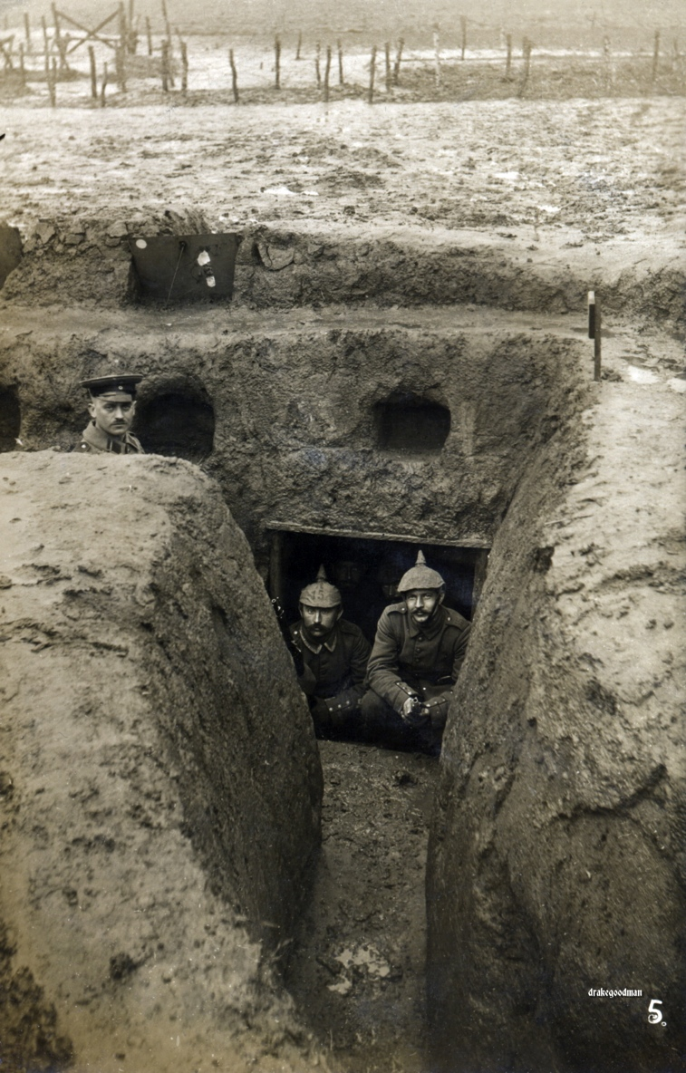
Trenches: What is the problem with Trench Warfare?

Slide 22
The War is Over…
November 11, 1918
“At the 11th hour on the 11th day of the 11th month of 1918, the Great War ends. At 5 a.m. that morning, Germany, bereft of manpower and supplies and faced with imminent invasion, signed an armistice agreement with the Allies in a railroad car outside Compiégne, France.”
- History Channel

Slide 23
C. United States Leadership as the War Ended:
NOTES
At the end of World War I, President Woodrow Wilson prepared a peace plan known as the Fourteen Points that called for the formation of the League of Nations, a peacekeeping organization.
U.S. President Woodrow Wilson pushed for a peace treaty that did NOT punish Germany for the war, but the European powers did not agree…

Slide 24
C. United States Leadership as the War Ended:
NOTES
3. The United States Senate did NOT ratify the Treaty of Versailles because of a desire to resume prewar isolationism.
4. The United States did NOT become a member of the League of Nations.

Slide 25
Summary of Wilson’s Fourteen Points:
Reliance on open diplomacy rather than secret arrangements
Freedom of the seas
Free Trade
Reduce the military forces and/or weapons
Readjust the colonies fairly
The allowance for Russia to self-determine its own government
Respect for Belgium’s Integrity
Restoration of the French Territory
Italy receives territory based upon ethnicity
Austria-Hungary receives fair development opportunities
Independence of the Balkan States
Creation of a Turkish state, and self determination for Ottoman Empire
Independence for Poland
The formation of a League of Nations to guarantee independence for all countries, small or large

Slide 26
How did WWI end? 1919 - The Treaty of Versailles

Slide 27
Brief Summary of the Treaty of Versailles:

Slide 28
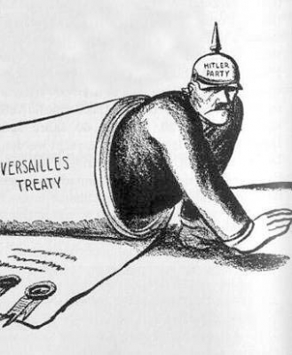
Looking to the Future?
Did the outcome of WWI almost guarantee that we would be fighting another World War in the near future?

Slide 29
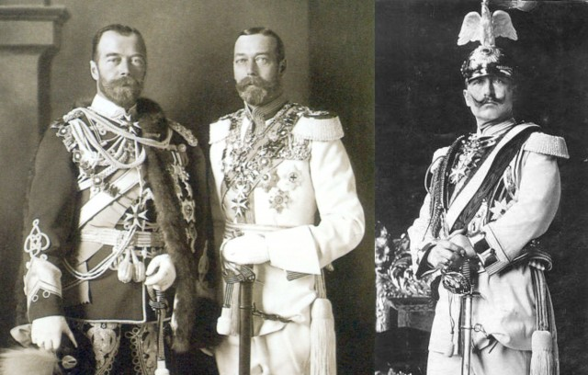
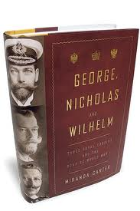
Why did the leaders of Great Britain, Russia, and Germany look so much alike?

