Slide 1
Progressive Movement
America’s Response to Industrialization

Slide 2
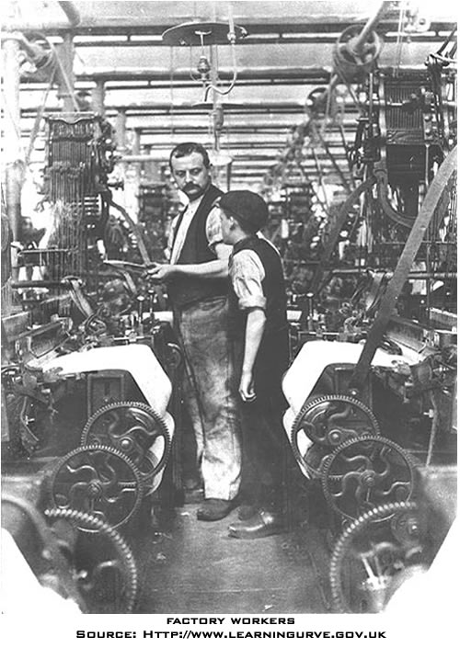
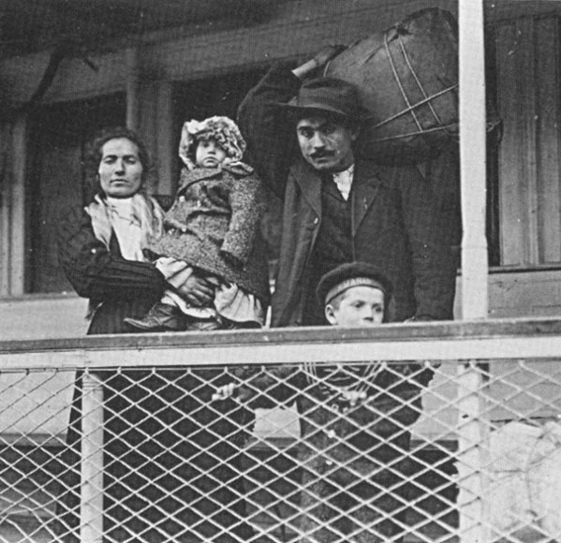
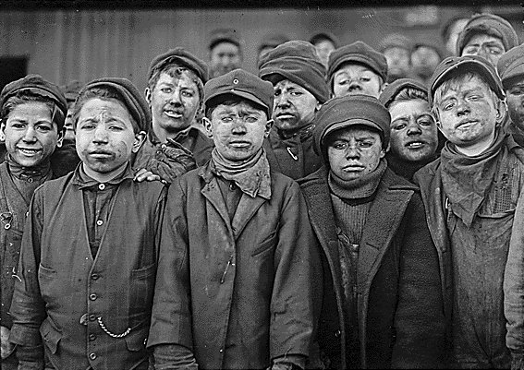
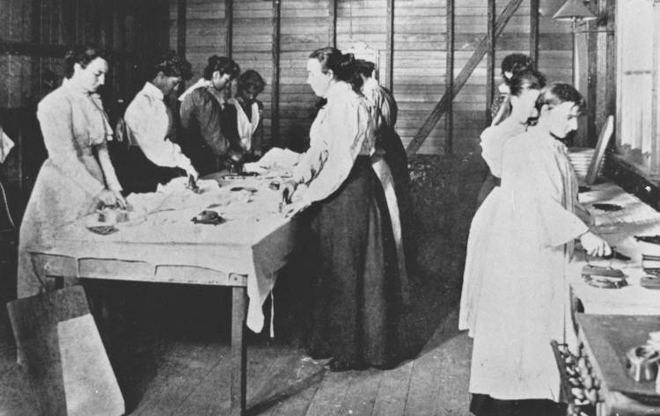
What groups in America needed help?
Immigrants
Factory Workers
Child Laborers
Women

Slide 3
L. Negative Effects of Industrialization:
Notes
Child Labor
Triangle Shirtwaist Factory Fire
Low Wages & Long Hours
Monopolies
Unsafe Working Conditions
Impact on the Environment

Slide 4
Child Labor
“Children were useful as laborers because their size allowed them to move in small spaces in factories or mines where adults couldn't fit, children were easier to manage and control and perhaps most importantly, children could be paid less than adults. Child laborers often worked to help support their families, but were forced to forgo an education.”
- History Channel

Slide 5
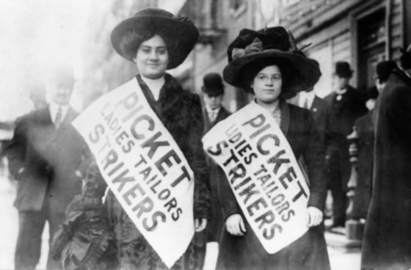
Unsafe Working Conditions
-Triangle Shirtwaist Factory Fire, New York

Slide 6
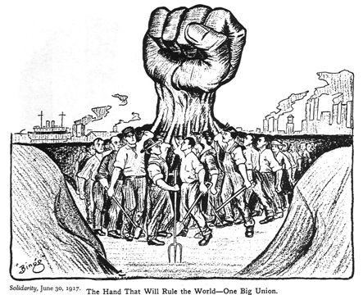
Introduction to Labor Unions:
Yes, this is a weird video…but I liked it anyway!!!
Click on TV for Intro Video
You don’t need to do the activities…just watch the movie. Stop the video when the written activity starts.

Slide 7
Notes
M. Rise of Organized Labor
Formation of Unions
Growth of the American Federation of Labor (AFL)
HIGHER WAGES
BETTER WORKING CONDITIONS
SHORTER WORK WEEK

Slide 8
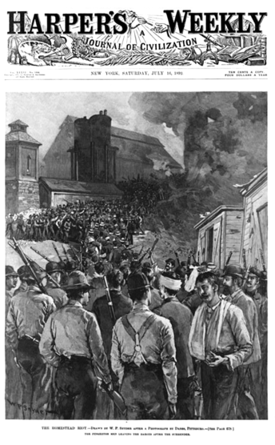
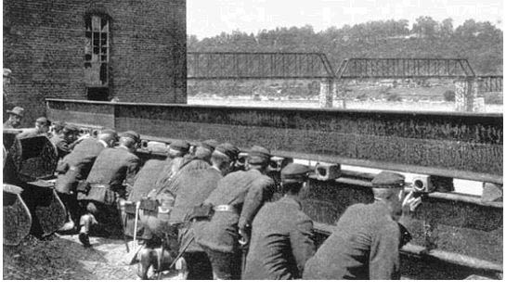
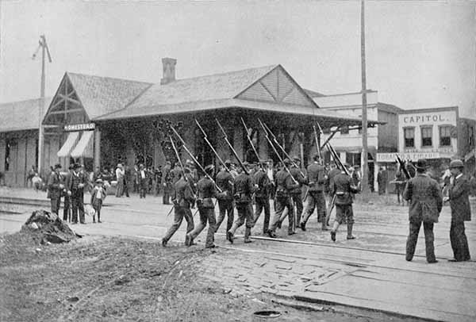
M. Rise of Organized Labor
Notes
Strikes

Slide 9
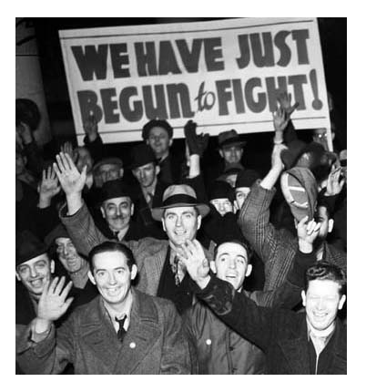
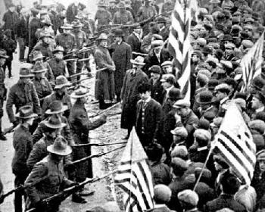
Labor Unions & Strikes:

Slide 10
What major strike at a Carnegie Steel Mill caused massive public outrage?
HOMESTEAD STRIKE
What major railroad strike led to federal troops intervening, a union boss in prison, and the declaration of Labor Day as a national holiday?
PULLMAN STRIKE

Slide 11
Progressive…What does it mean?
N.
What is the root word in Progressive?
Progress: “Steady improvement, as of a society or civilization”
Does Progress have a prefix?
Pro = Positive
What was the Progressive Movement?
Movement to IMPROVE the lives of ALL AMERICANS.

Slide 12
O. Progressive Movement REFORMS
Notes
Improved Safety Conditions in the workplace
Placed Restrictions on Child Labor
Reduced Work Hours

Slide 13
P. Women’s Suffrage Movement:
Notes
What was the Women’s Suffrage Movement?
The fight for women to be able to vote.
SUFFRAGE = VOTING

Slide 14
P. Women’s Suffrage Movement:
Anti-Women’s Suffrage Viewpoint:
Caption: “What, Dinner Not Ready Yet! What Have You Been Doing?”

Slide 15
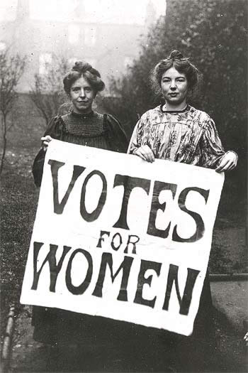
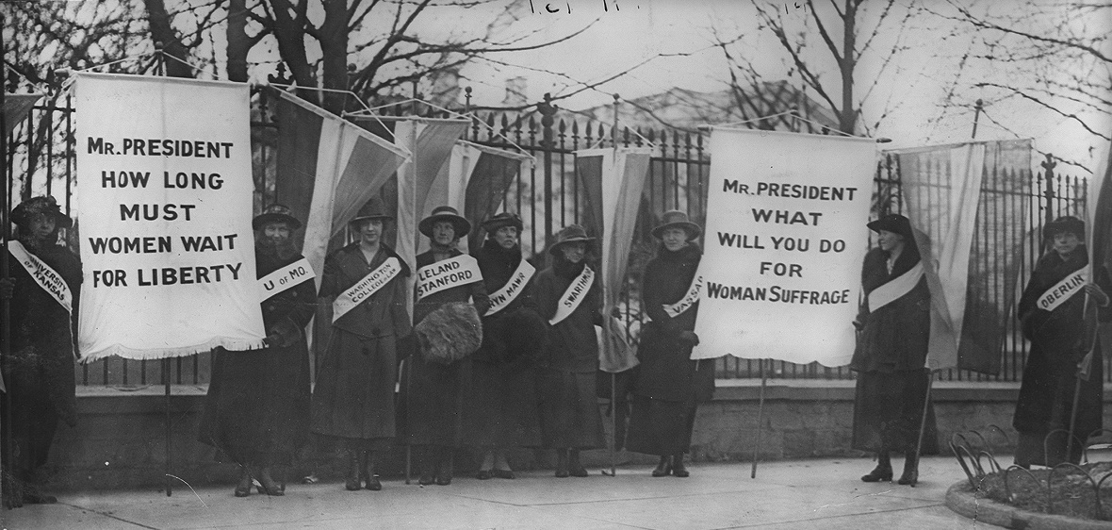
P. Women’s Suffrage
Notes
Susan B. Anthony, Elizabeth Cady Stanton, Alice Paul, and Lucy Burns worked for women’s suffrage.
The movement led to increased educational opportunities for women.
Women gained the right to vote with passage of the 19th Amendment to the Constitution of the United States.

Slide 16
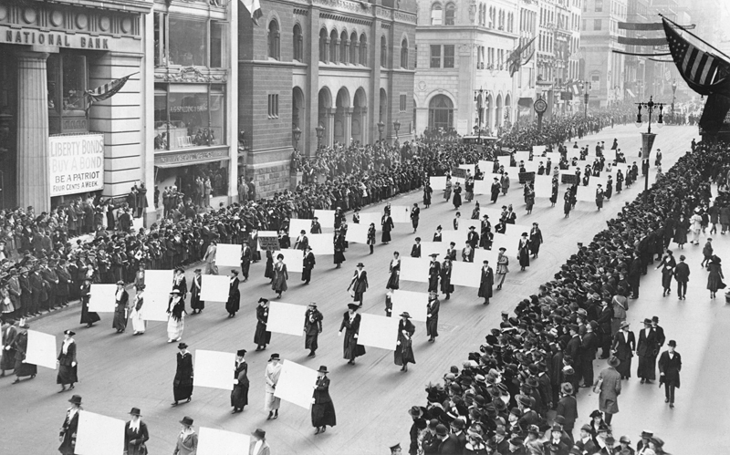
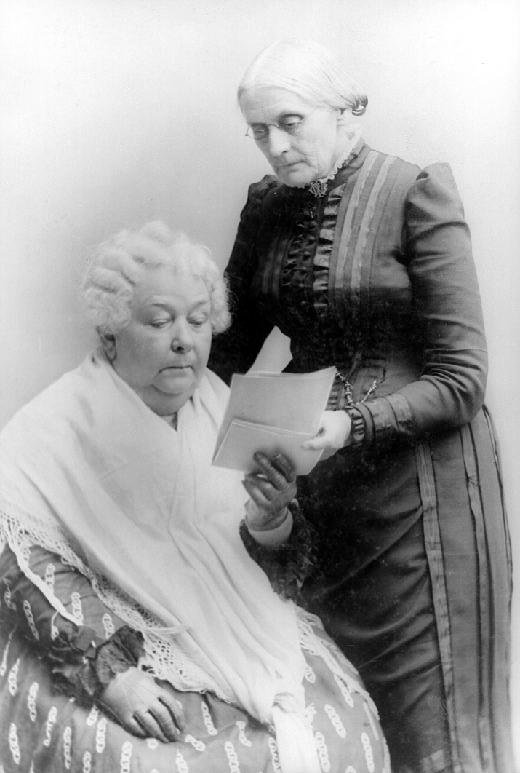
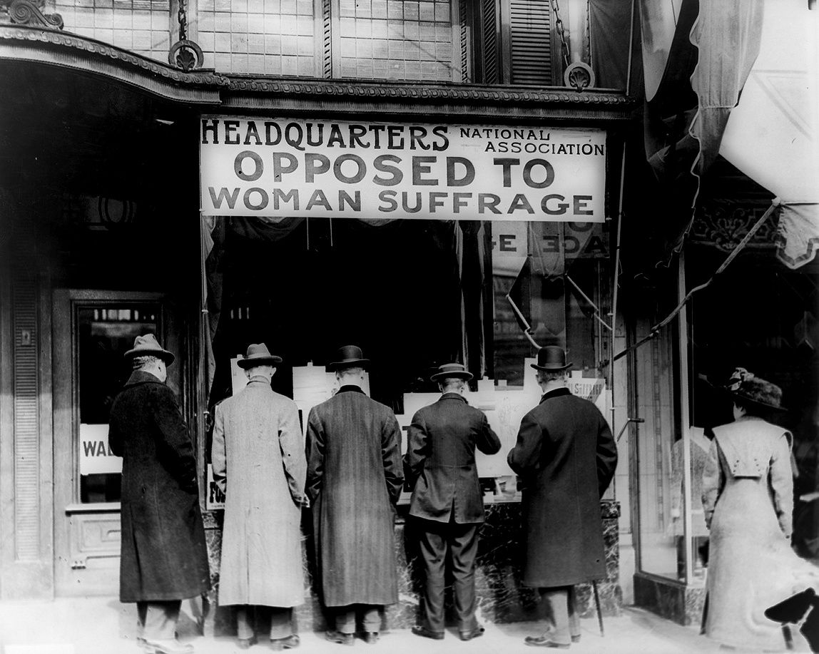
P. Women’s Suffrage
Susan B. Anthony
Women’s suffrage parade down Fifth Avenue in NYC
Elizabeth Cady Stanton

Slide 17
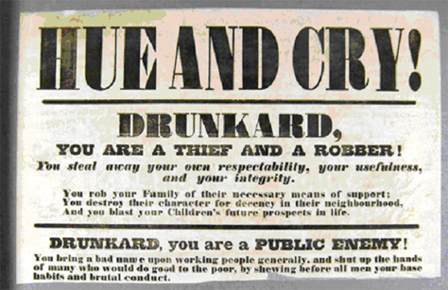
More Progressive Changes… Anti-Alcohol Movement
Progressive reformers wanted to ban alcohol for social reasons; others wanted to ban it for religious or moral reasons
*DON’T WRITE THIS DOWN…NOTES ARE ON THE NEXT SLIDE

Slide 18
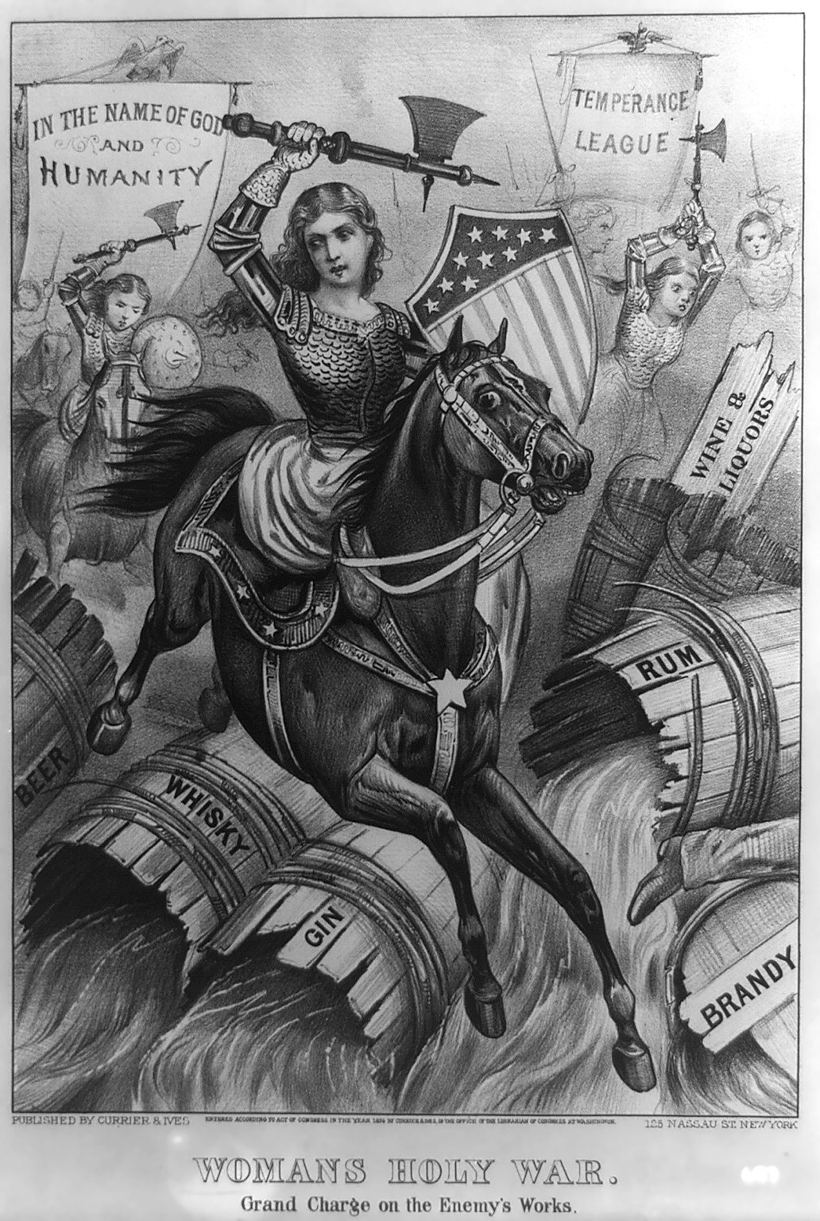
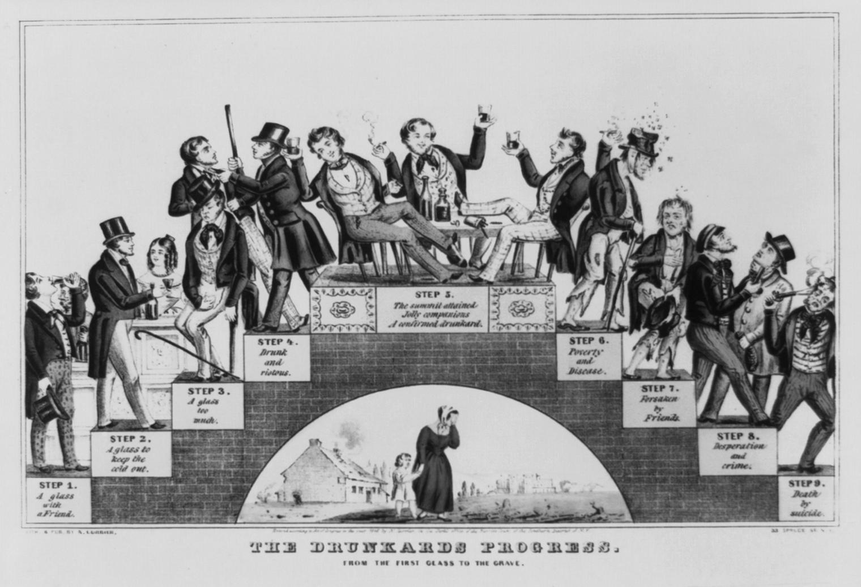
Q. Temperance Movement
Notes
Composed of groups opposed to the making and consuming of alcohol.

Slide 19
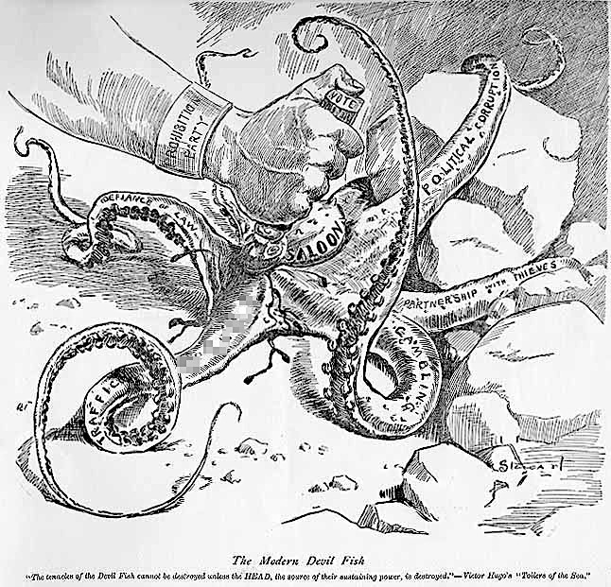
Q. Temperance Movement
Notes
2. Supported legislation to ban alcohol
3. This led to the passing of the 18th Amendment.

Slide 20
What happened AFTER the 18th Amendment was passed?
Notes
This led to the PROHIBITION
period during the 1920’s.

