Slide 1
Post-WWII America
Time of Prosperity!
USII.8b

Slide 2
What contributed to the prosperity of Americans following World War II?
Following World War II, Americans prospered due to an expanding economy stimulated by America’s involvement in the war.

Slide 3
Postwar: Life in America
Start at 01:00

Slide 4
U.S Economy after WWII…
Now that Americans didn’t have to ration, factories started making more __________ goods for them to buy!
Americans purchased goods on ______!
Buy now…pay later!
consumer
credit

Slide 5
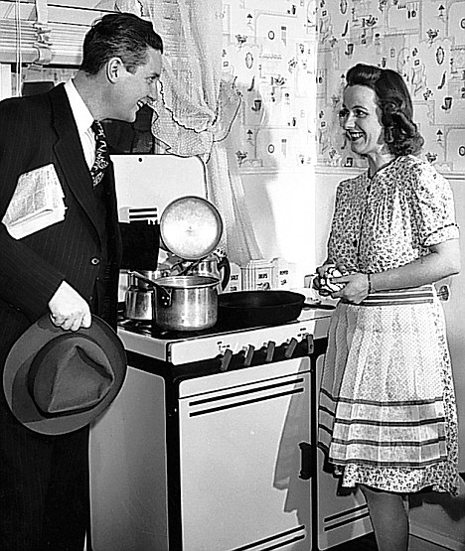
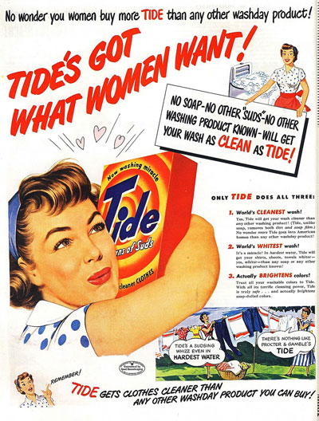
Work Force…
Jobs went back to mostly _____
Women returned ________ to their family ______________
men
full-time
responsibilities

Slide 6
Labor Unions…
_____________ came together and became more powerful!
Workers gained new ________ and higher ________.
Labor Unions
benefits
salaries

Slide 7
Post-war: Labor Unions

Slide 8
Changes for Women
Legacy of Rosie the Riveter…
As American economic prosperity continued and ___________ boomed, the next generation of women entered the ___________ in large numbers.
technology
labor force

Slide 9
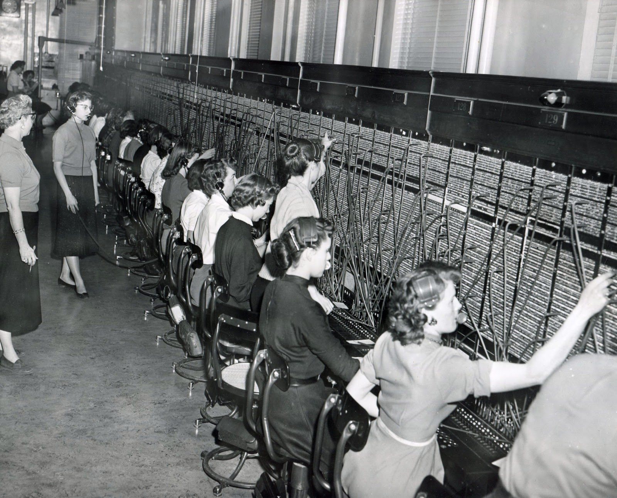
Technology-Impacted
careers for women….
Telephone Switchboard Operators

Slide 10
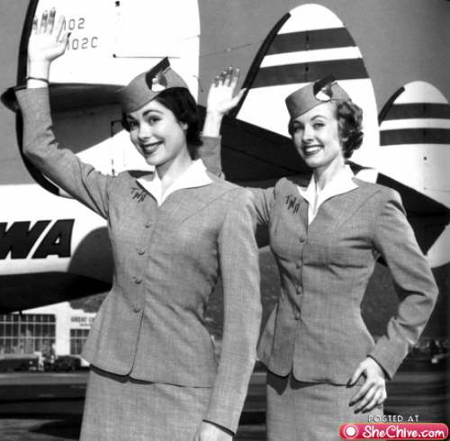
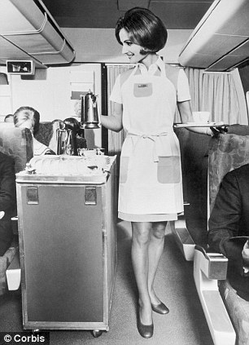
Technology-Impacted
careers for women….
Airline Flight Attendants

Slide 11
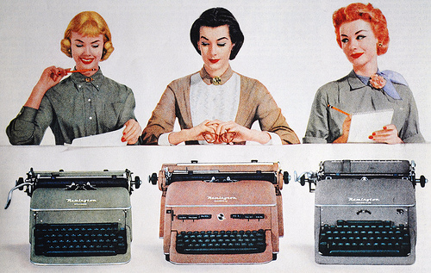
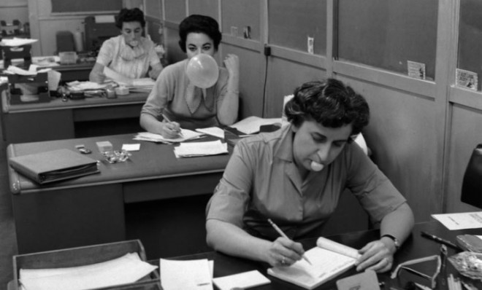
Technology-Impacted
careers for women….
Secretaries

Slide 12
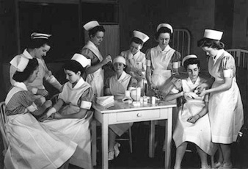
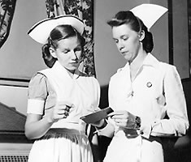
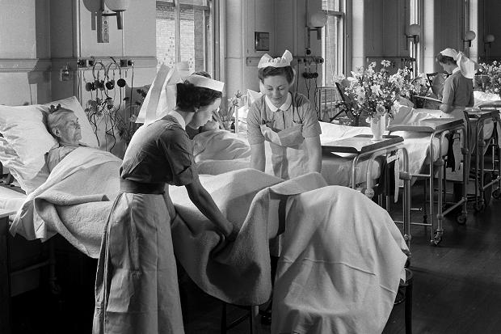
Nursing
Advances in medicine created more opportunities for women to work in the medical field.

Slide 13
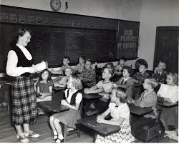
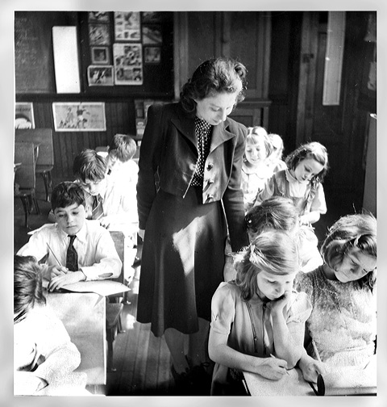
Teachers
After WWII, the American public school system boomed…creating more jobs for women

Slide 14
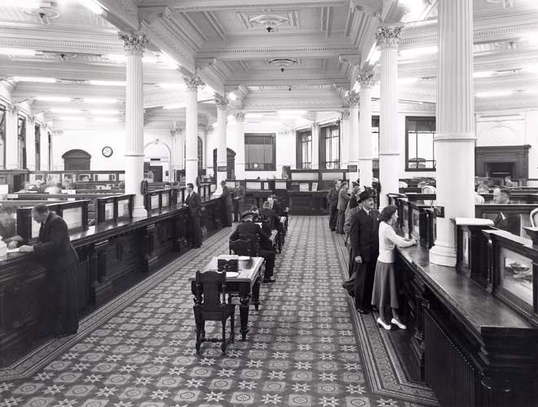
With technology, industry, housing, and business booming, so did American banks. This created job opportunities for women to work as bank tellers.
Bank
Tellers

Slide 15
N. Reasons for Rapid Growth of the American Economy
With rationing of consumer goods over, businesses converted from production of _____ materials to ____________ goods.
Americans purchased goods on ________.
The work force shifted back to ______ and most _________ returned __________ to _______ responsibilities.
Labor Unions ___________ and became more __________. Workers gained new ___________ and _________ salaries.
As ___________ prosperity continued and ______________ boomed, the next generation of _________ entered the ________ force in large numbers.
war
consumer
credit
men
women
full-time
family
merged
powerful
benefits
higher
economic
technology
women
labor
Time to fill in your notes….

