Slide 1
The Jim Crow Era
End of Reconstruction – GREAT MIGRATION

Slide 2
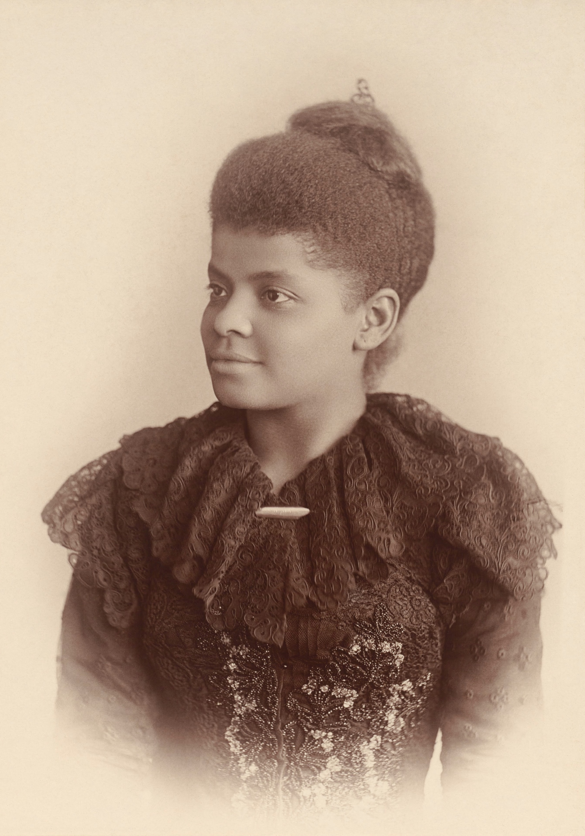
Ida B. Wells Barnett:
“Ida B. Wells-Barnett was a prominent journalist, activist, and researcher, in the late 19th and early 20th centuries. In her lifetime, she battled sexism, racism, and violence. As a skilled writer, Wells-Barnett also used her skills as a journalist to shed light on the conditions of African Americans throughout the South.”
Arlisha R. Norwood, NWHM Fellow
National Women’s History Museum

Slide 3
USII.4c & 6b Vocabulary
Jim Crow Laws | Vocational Training
Segregation | The Atlanta Compromise
Discriminate/Discrimination | W.E.B. DuBois
Booker T. Washington | Niagara Movement

Slide 4
Timeline:
November 1865:
Southern States began passing BLACK CODES
1863 – Emancipation Proclamation & Start of Reconstruction
1865 – 13th Amendment
1868 – 14th Amendment
1870 – 15th Amendment
1877 – End of Reconstruction
1877 – Start of the Jim Crow Era
1895 – Booker T. Washington’s Atlanta Exposition Address (aka the Atlanta Compromise)
1905 – W,E.B. DuBois’ Niagara Movement
1910 – 30 The Great Migration
1920 – Harlem Renaissance (Jazz Age/Roaring 20’s)
1930 – End of the Great Migration/Harlem Renaissance

Slide 5
Let’s Review the 13th, 14th, and 15th Amendments
Passed during Reconstruction when the Radical Republicans controlled the United States Congress:
13th Amendment – Banned Slavery in the U.S.
14th Amendment – Granted Citizenship to Former Slaves
15th Amendment – Gave Former Slaves the Right to Vote
History Tunes: 13th, 14th ,15th Amendment Song

Slide 6
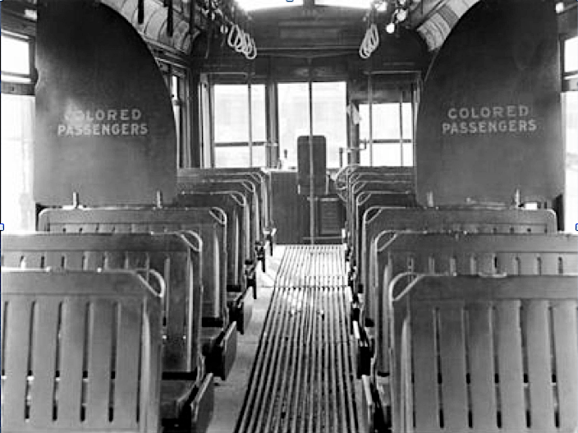
G. What is Racial Segregation?
NOTES
Segregation = To Separate

Slide 7
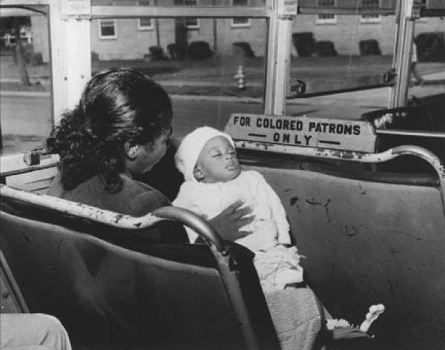
G. Racial Segregation
NOTES
Based upon ______.
Directed primarily at ______________________, but other groups were also kept segregated.
________________________ of ______ provided an absolute 10-year moratorium (halt) on Chinese labor immigration.
American _________ were not considered citizens until 1924.
race
African Americans
Chines Exclusion Act
1882
Indians

Slide 8
H. “Jim Crow” Laws
NOTES
discriminate
Passed to ____________ against African Americans.
Made discrimination practices _____ in many communities and states.
Were characterized by unequal opportunities in ________, _____, __________, and ___________.
Segregation was upheld by the Supreme Court in _______ vs. _________.
legal
housing
work
education
government
Plessy
Ferguson

Slide 9
AFRICAN AMERICAN RESPONSE
BOOKER T. WASHINGTON
& W.E.B. DUBOIS

Slide 10
History Tunes
Booker T. Washington
W.E.B. DuBois
VS
2 Videos:
Mini Bio
Tuskegee Institute
2 Videos:
Niagara Movement
Rivalry w/ Booker T. Washington
Directions:
Click on the “bio” links for a brief biography with videos on each leader’s response to Jim Crow.
As you read/watch, complete the Venn diagram in your notes.
Make sure to include When & Where each man was born, plus what type of education they had.
Answer the discussion questions below your Venn diagram.

Slide 11
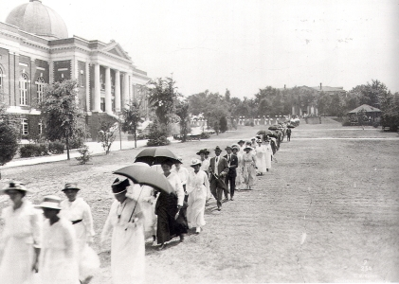
Booker T. Washington
NOTES
Believed equality could be achieved through ___________ education.
He __________ social segregation as a way to improve the economic situation for African Americans.
His had a ________ approach to equality.
vocational
Tuskegee Institute
accepted
gradual

Slide 12
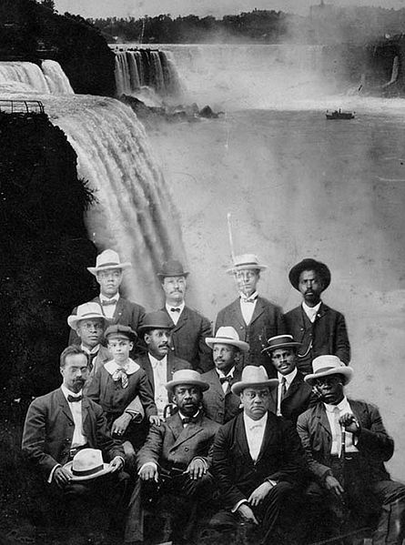
W.E.B. DuBois
NOTES
Believed in full ________, ____, and ______ rights for African Americans.
He believed the ________________ would lead African Americans in the fight for equality.
One of the founders of the ________ along with _____________________.
political
civil
social
“Talented Tenth”
NAACP
Ida B. Wells-Barnett

