Slide 1
Immigration & the growth of Cities
USII.4b

Slide 2
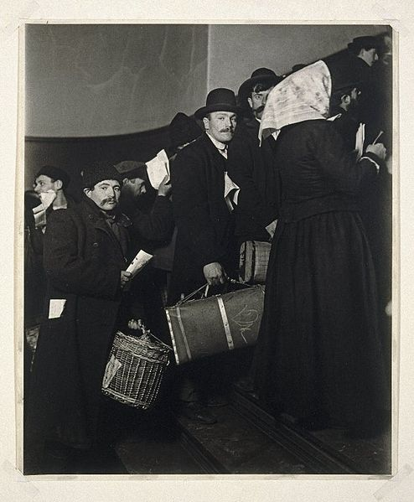
A. Reasons for increase in immigration
Hope for better opportunities
Desire for religious freedom
Escape from oppressive governments
Desire for adventure

Slide 3
B. Reasons why cities grew and developed

Slide 4
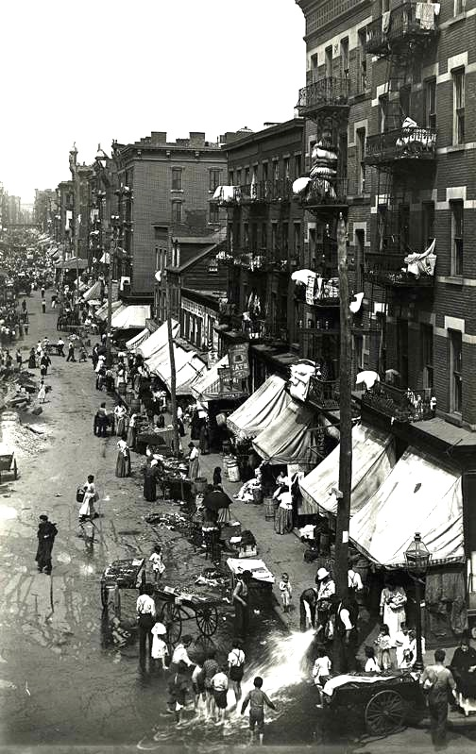
B. REASONS WHY CITIES GREW & DEVELOPED
Specialized industries, including steel in Pittsburgh, meat packing in Chicago, and automobiles in Detroit.
Immigration to America from other countries
Movement of Americans from rural to urban areas for job opportunities.

Slide 5
C. GROWTH OF CITIES…NEGATIVE IMPACT
QUESTION:
How could rapid growth of cities such as NYC be bad?
Brainstorm with your pod.

Slide 6
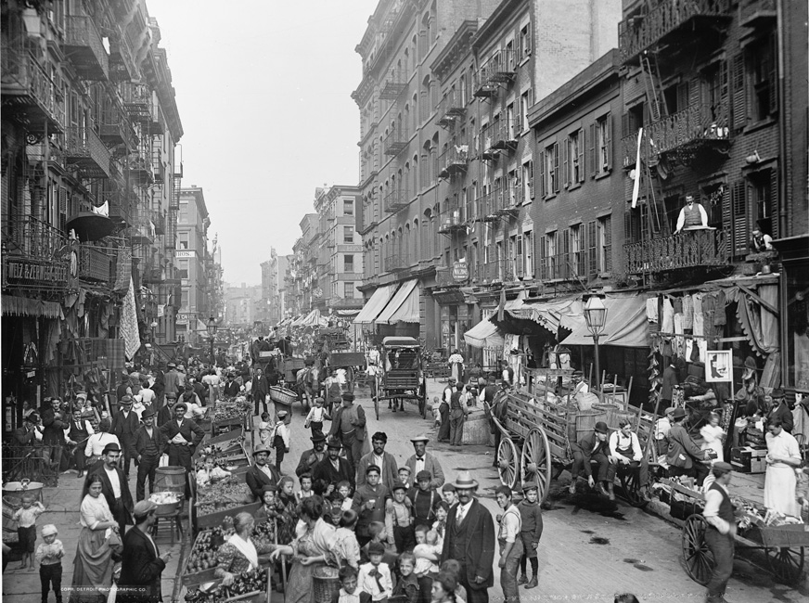
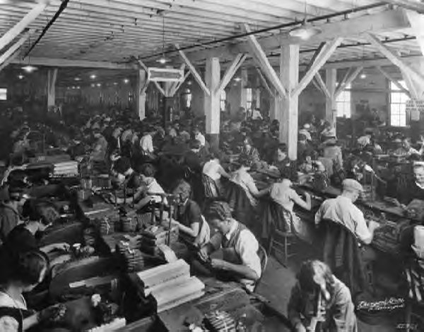
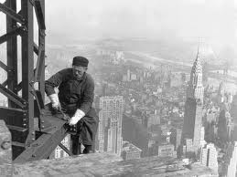
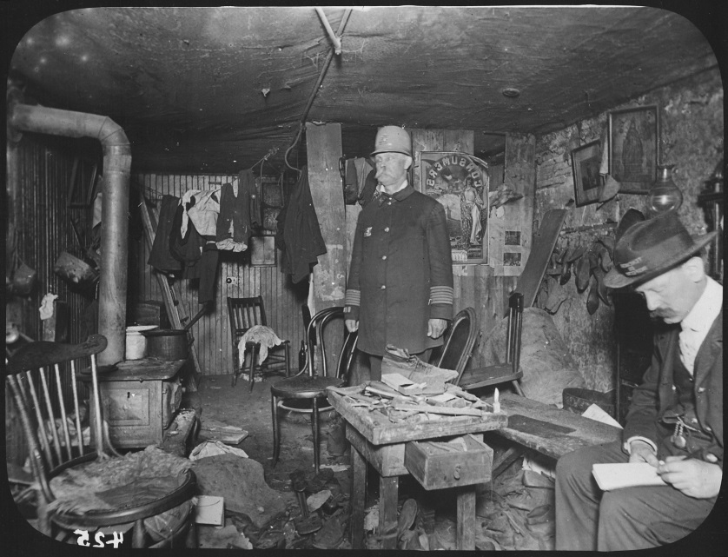
C.
Overcrowded Immigrant Neighborhoods
Rapid Industrialization
Led to…
Rapid Urbanization
Tenements

Slide 7
Want to learn more life in the tenements?
Tufts University:
Jacob Riis Collection
The New York Public Library
http://on.nypl.org/1IonjY3
bit.ly/1ILcEdv

Slide 8
Five Points…NYC Tenement Neighborhood
From “The Gangs of New York” movie
Primary image of the same neighborhood

Slide 9
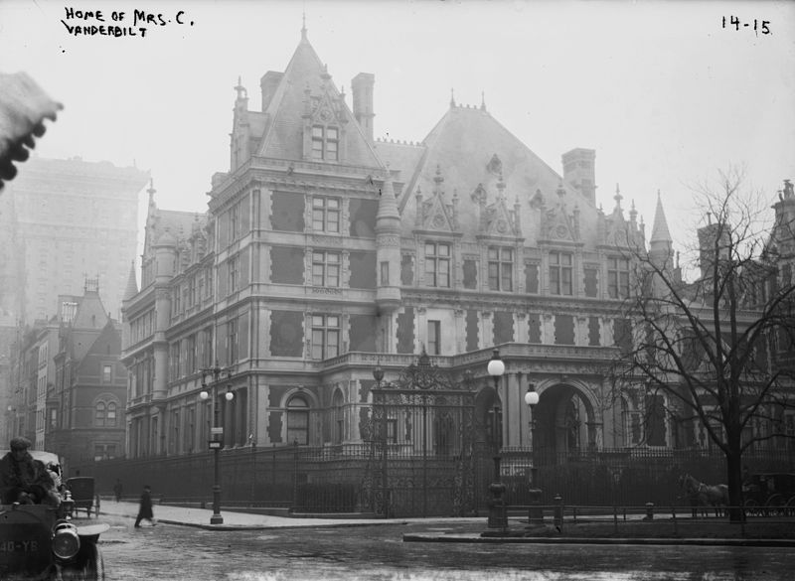
In comparison…
VANDERBILT MANSION
Astor family home on Fifth Ave.
Fifth Avenue during 19th century

Slide 10
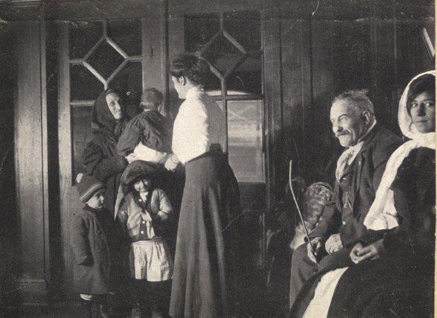
D. Efforts to solve the immigration problem
Settlement Houses
& Political Machines

Slide 11
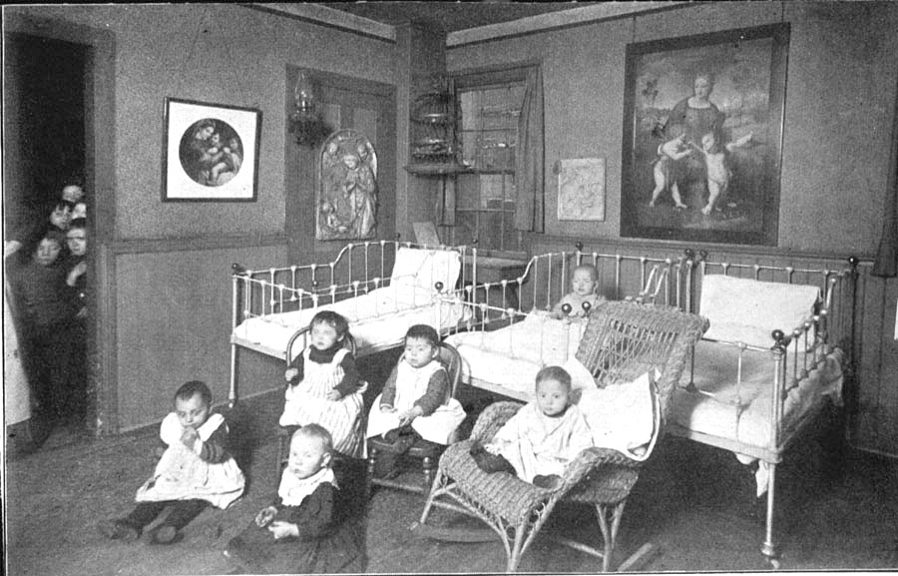
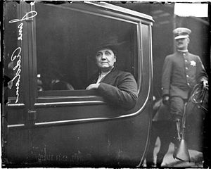
D. Efforts to Solve the Immigration Problem
SETTLEMENT HOUSES, such as HULL HOUSE founded by
JANE ADDAMS

Slide 12
D. Efforts to Solve the Immigration Problem
2. POLITICAL MACHINES that
gained POWER by attending to the
NEEDS of new IMMIGRANTS
Ex. JOBS and HOUSING

Slide 13
Political Machines…Tammany Hall
“Boss Tweed”

Slide 14
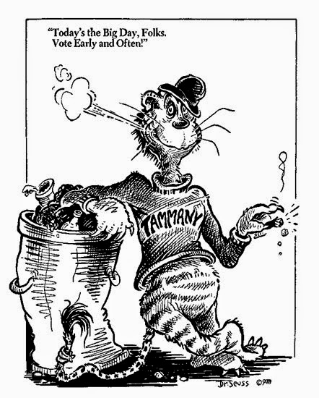
Political Machines…Tammany Hall

Slide 15
E. Discrimination Against Immigrants
1. Chinese
2. Irish

Slide 16
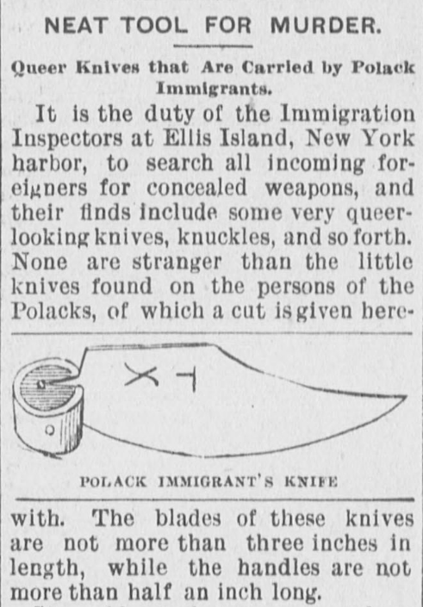
E. Discrimination Against Immigrants
3. Jewish
4. Italian
5. polish

Slide 17
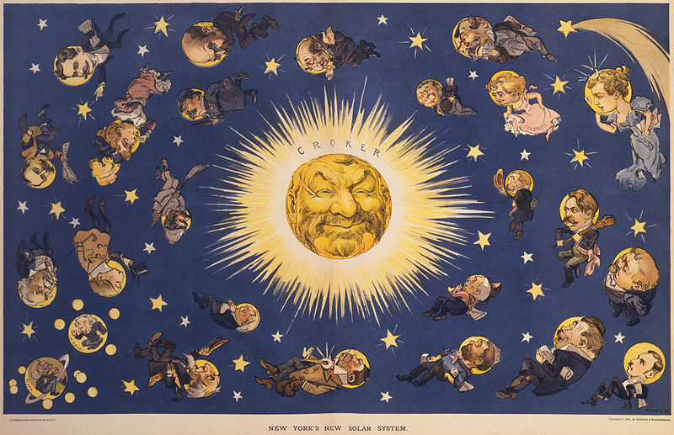
F. Challenges Faced by Cities…
1. TENEMENTS & GHETTOS
2. POLITICAL CORRUPTION…from Political Machines such as Tammany Hall

Slide 18
Vocabulary…Let’s start with some suffixes!
“- ization”
= the Process of Becoming

Slide 19
Who was being discriminated?
Irish & Chinese Immigrants
Who was discriminating them???
“Natives”
= Americans of English Decent
Nativism = a policy of favoring native inhabitants as opposed to immigrants

