Slide 1
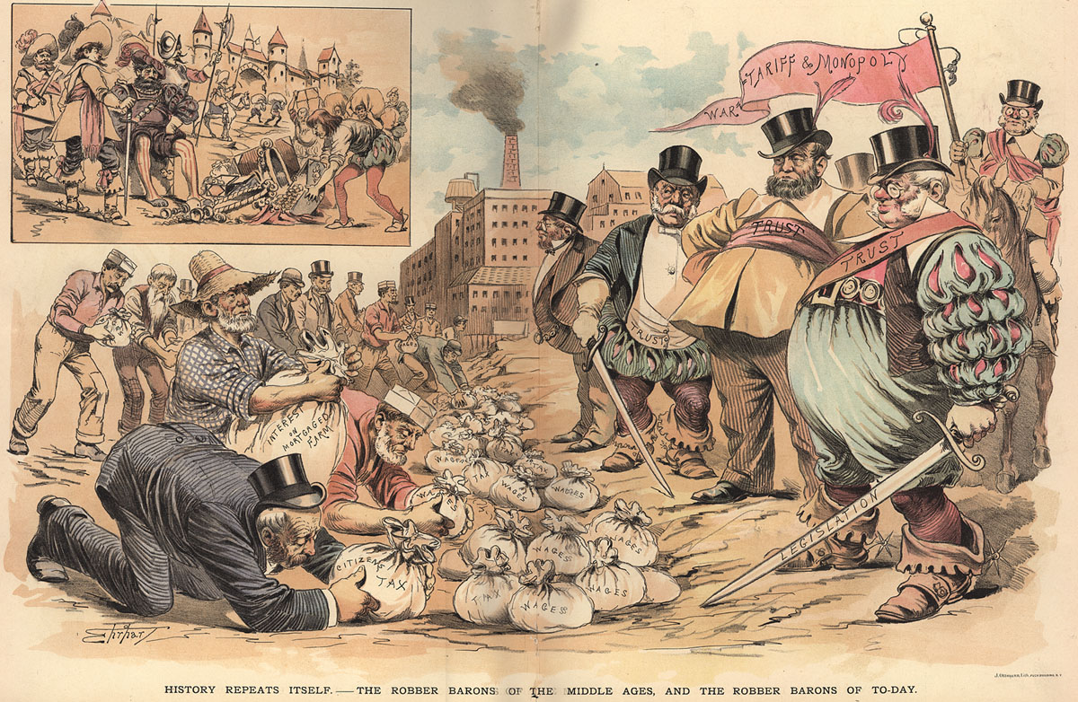
Captains of Industry or Robber Barons?

Slide 2
The Gilded Age 1870 - 1900
An era of economic growth, industrial expansion, unstable politics and high immigration.
Marked by advances in technology, transportation, communications and energy.
A few individuals became wealthy while many Americans lived in poverty and were overtaken by the corporate world.

Slide 3
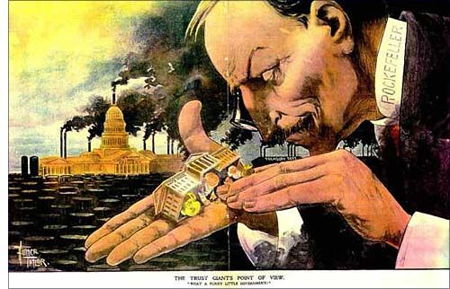
Social Darwinism:
Refers to Darwin’s theory that “only the strong survive”.
Used by Big Business men to justify what they did.
Notes:
Q: What do these Business Organizations all have in common?
A: They limit competition and keep all of the wealth and resources in the hands of a small few.

Slide 4
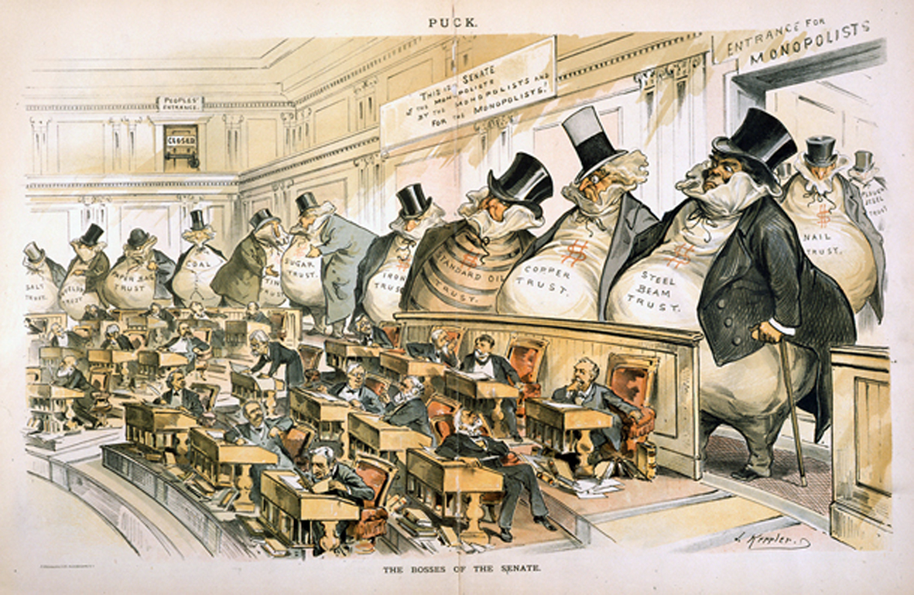
Lassiez-faire Policies:
The Government’s “hands off” policy of business practices & people - no government regulations.

Slide 5
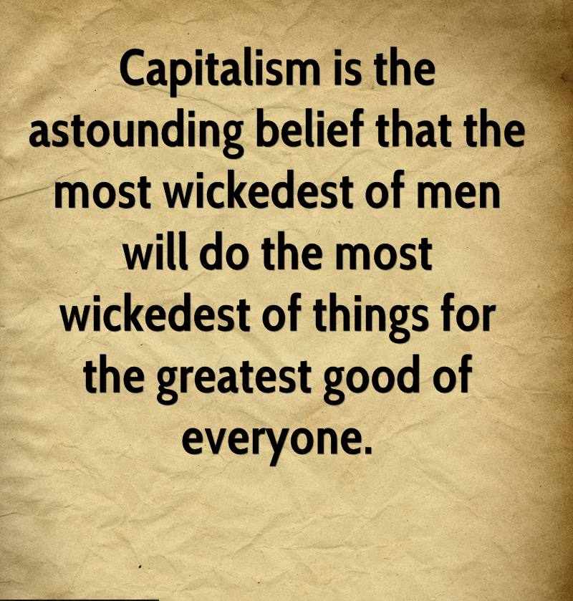
Capitalism:
An economic system in which industries are privately owned, and the prices, production, and distribution of goods are determined by competition on a free market.
John M. Keynes – British Economist

Slide 6
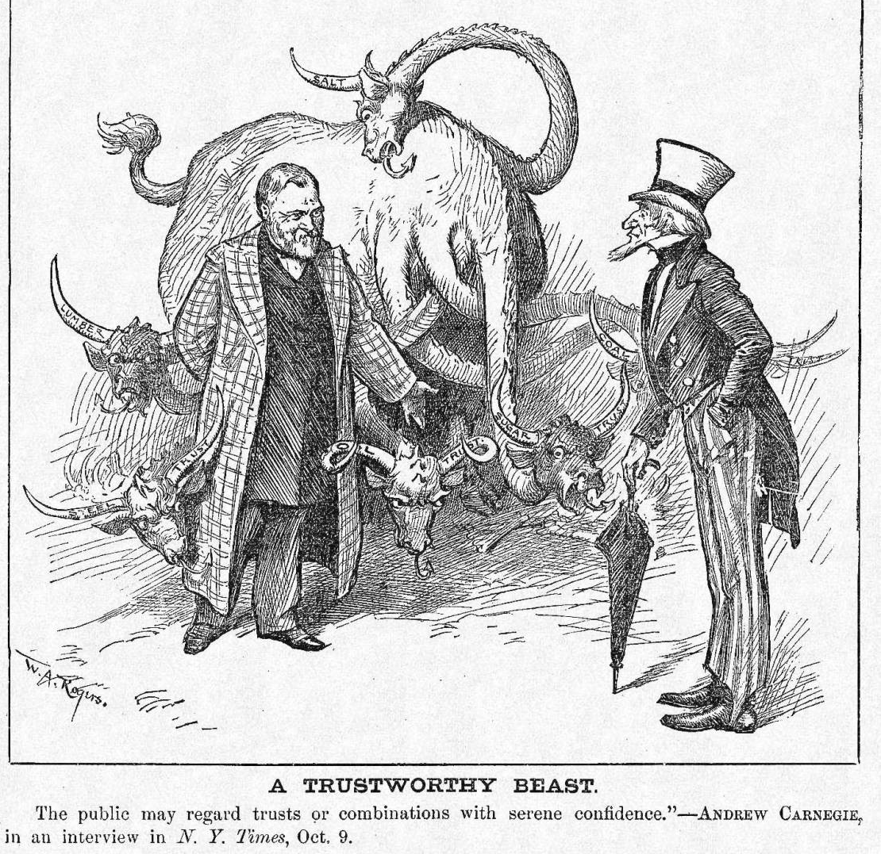
Trust:
An alliance of companies, run by a board of trustees, that function as one company.

Slide 7
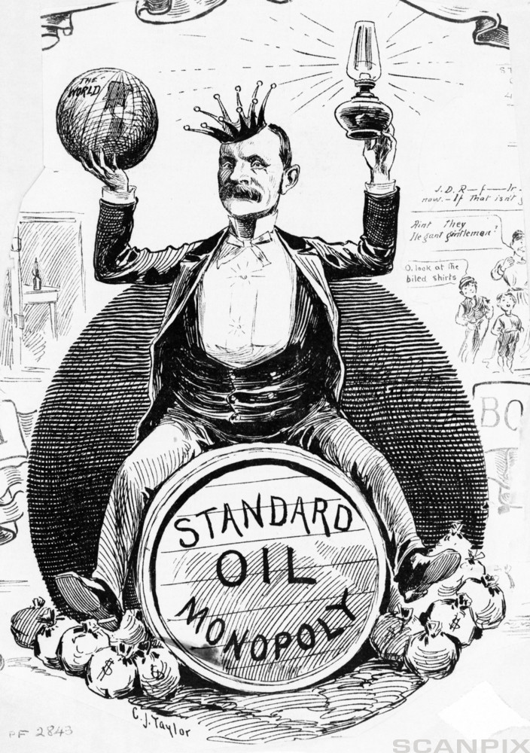
Monopoly:
A situation in which one company has eliminated its competition and controls the market.

Slide 8
Captains of Industry vs. Robber Barons?
Captain of Industry
Robber Baron
Increases availability of goods by building factories
Raises productivity
Expands markets
Creates more jobs
Funds many of the nation’s public institutions and practices philanthropy (giving generously to charitable causes)
Drains the country of its natural resources.
Corrupts public officials to interpret laws in their favor.
Drives competitors to ruin
Pays poor wages
Forces workers to toil under dangerous and unhealthy conditions

Slide 9
Big Business Industrialists
Henry Ford – Transportation
Net worth: $199 billion
Business: Ford Motor Company (Ford is the second-largest U.S.-based automaker and the fifth-largest in the world).
John D. Rockefeller – Oil Net worth: $340 billion
Business: Standard Oil (at its peak, controlled 90% of all oil companies)
Andrew Carnegie – Steel
Net worth: $310 billion
Business: Carnegie Steel Company (controlled raw materials, manufacturing, storage, and distribution for steel).
Cornelius Vanderbilt – Transportation
Net worth: $185 billion
Business: New York Central Railroad
J.P. Morgan – Finance
Net worth: $41.5 billion
Business: J.P. Morgan & Co. (financed railroads and helped organize U.S. Steel, General Electric and other major corporations).

