Slide 1
Industrial Revolution
Late 1800’s – Early 1900’s

Slide 2
G. Inventions that contributed to GREAT CHANGE & INDUSTRIAL GROWTH:
1. Electric Lighting
Invented by Thomas Edison
“Banished the Night”
Factories could now stay open later, therefore workers began working longer hours

Slide 3
G. Inventions that contributed to GREAT CHANGE & INDUSTRIAL GROWTH:
2. Telephone Service
Invented by Alexander Graham Bell
Helped businesses, markets, and railroads across the country to communicate

Slide 4
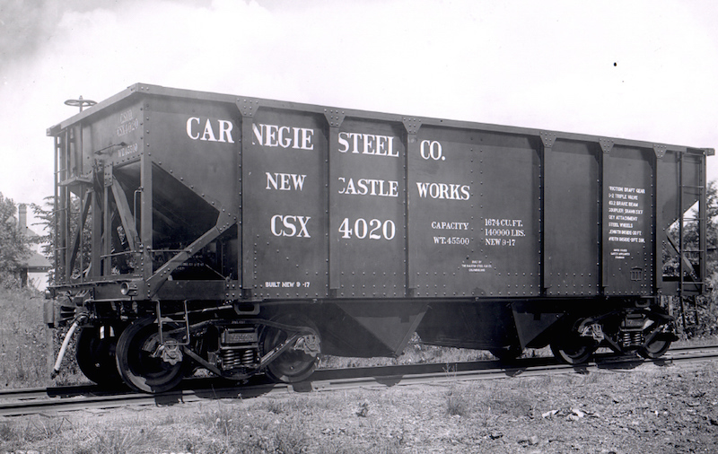
G. Inventions that contributed to GREAT CHANGE & INDUSTRIAL GROWTH:
3. Railroads
Which permitted large-scale, long-distance transport of goods

Slide 5
H. Reasons for Business Growth
1. National Markets
Created by Advances in Transportation
Railroads linked…
Factories – Produced Goods
Consumers – Purchased Goods

Slide 6
H. Reasons for Business Growth
2. Advertising

Slide 7
H. Reasons for Business Growth
3. Lower-cost Production
ASSEMBLY LINE
More Goods Produced in Less Time
Goods Cost Less Money to Manufacture
Goods can then be sold to the consumer for a cheaper price!

Slide 8
H. Reasons for Business Growth
4. Captains of Industry
John D. Rockefeller
Andrew Carnegie
Cornelius Vanderbilt
JP Morgan
Lack of competition because of monopolies and trusts

Slide 9
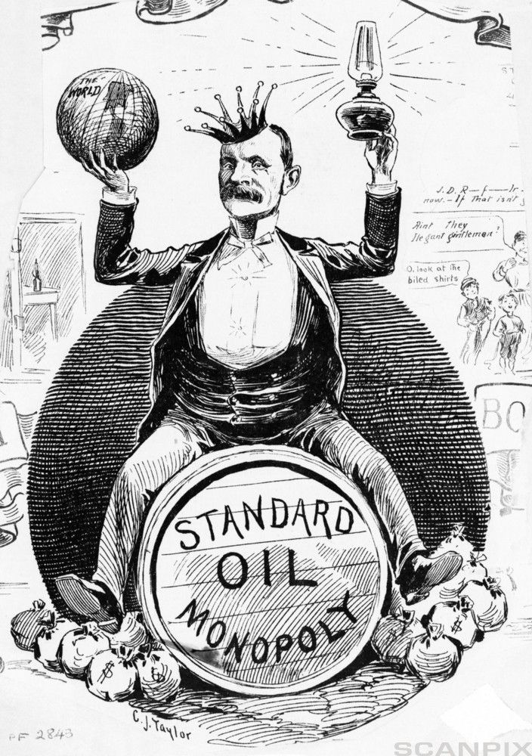
What is a MONOPOLY?
A monopoly is when a single person or company controls the entire supply of goods or services in a market.

Slide 10
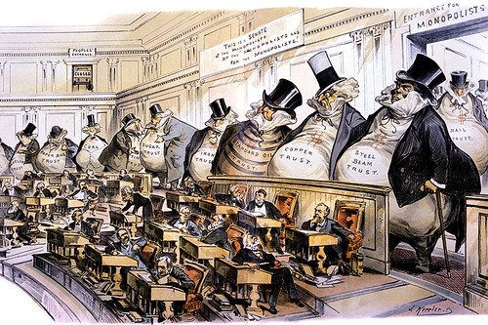
What is a TRUST?
A trust is when multiple companies in an industry join together to reduce competition in the market.

Slide 11
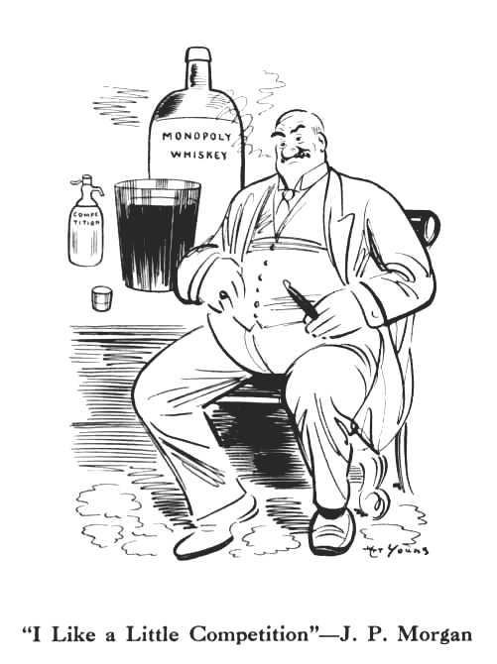
Why is product COMPETITION good for the national market?
When companies compete with each other, the consumer chooses the best option to purchase.
Choice ensures that customers get the best quality, quantity, and price for a good or service.
The government’s Anti-trust laws are designed to make companies compete with each other to benefit customers and encourage new ideas in the market.

Slide 12
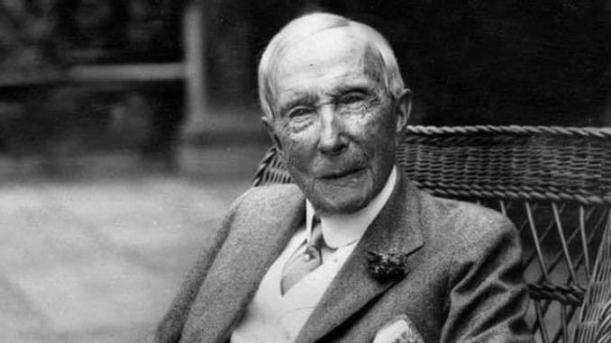
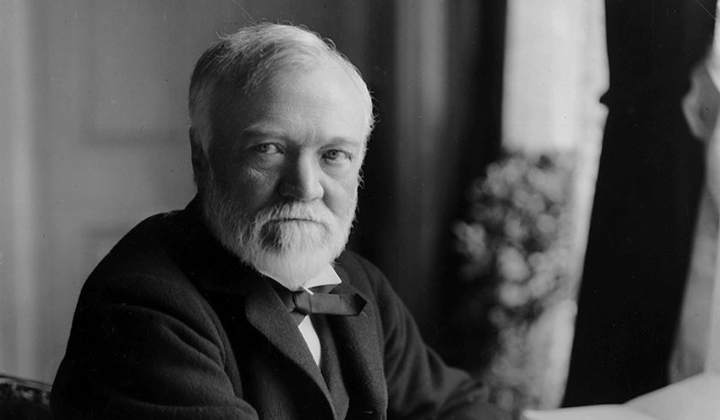
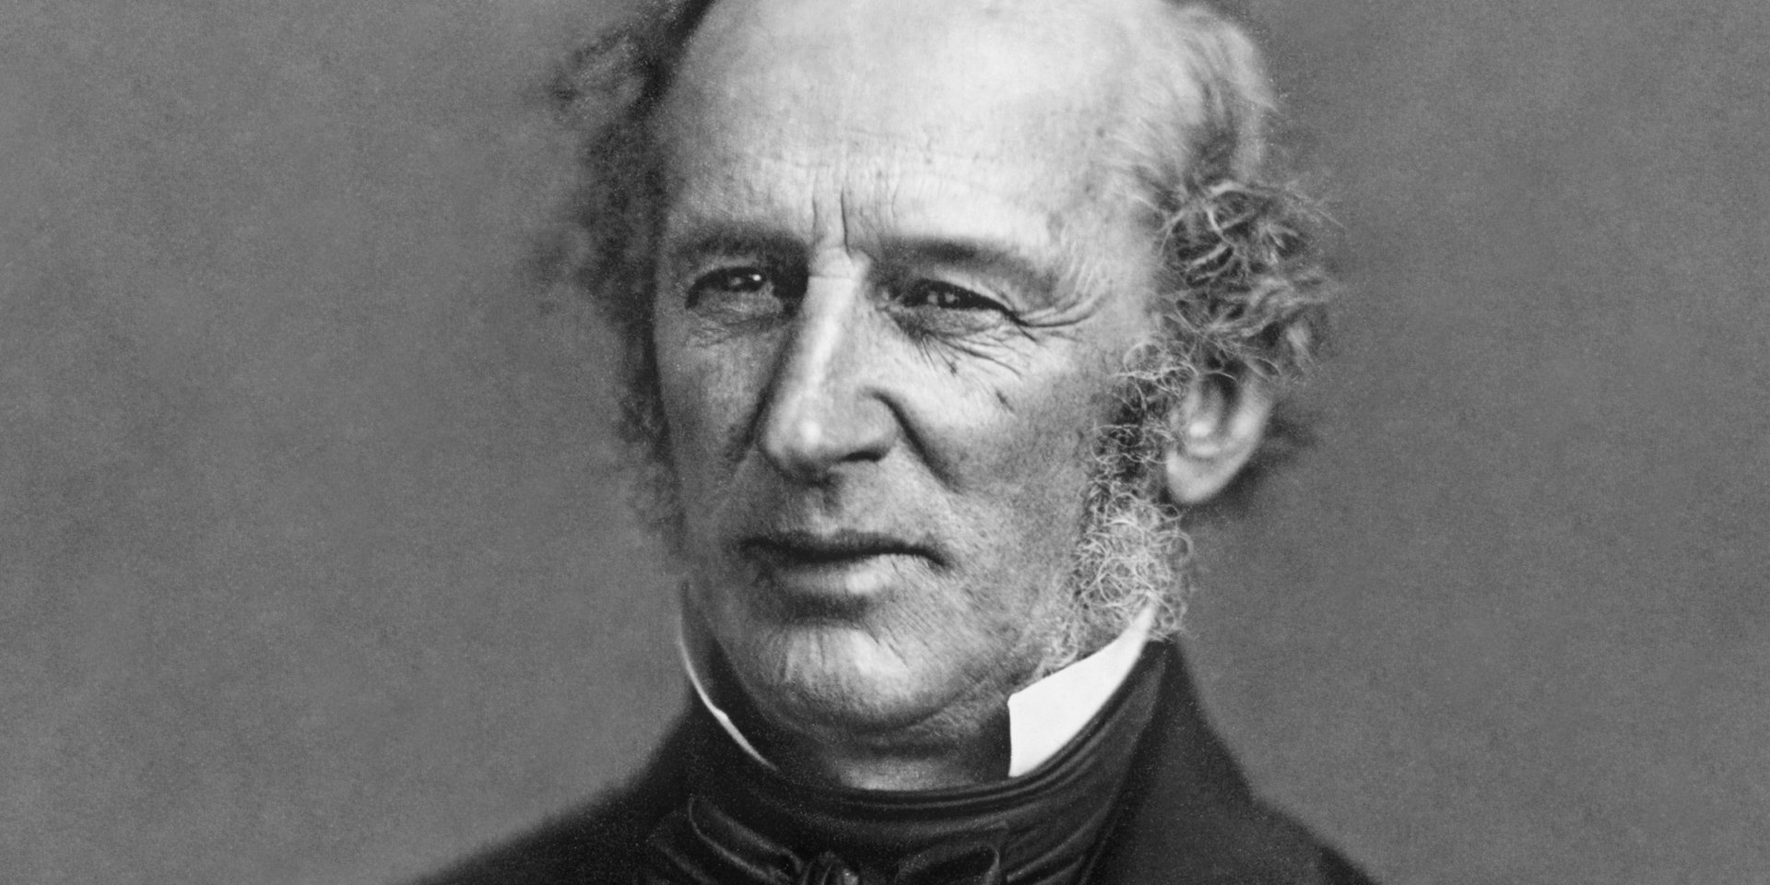
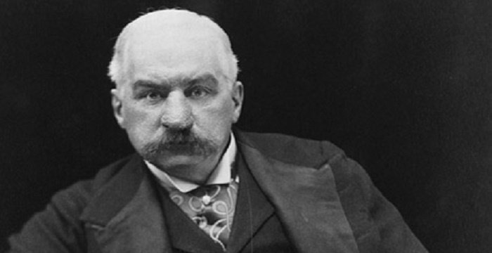
Rise of BIG BUSINESS led by the CAPTAINS OF INDUSTRY:
OIL | STEEL | SHIPPING & RAILROADS | BANKING
John D. Rockefeller | Andrew Carnegie | Cornelius Vanderbilt | J.P. Morgan

Slide 13
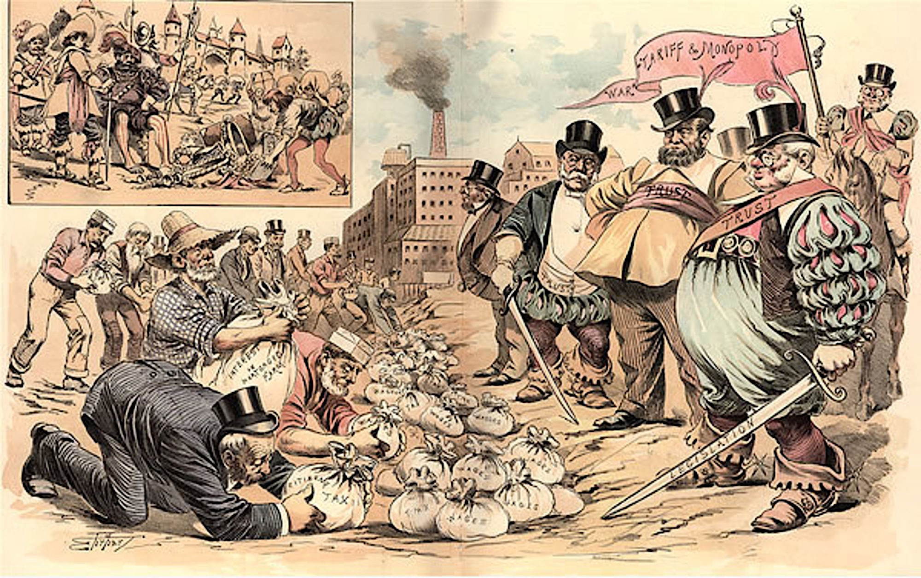
Why did some people refer to the
Captains of Industry as “Robber Barons”?

Slide 14
I. FACTORS that promoted INDUSTRIAL GROWTH in America:
1. Access to Raw Materials and Energy Sources
2. Availability of work force due to Immigration
3. New Inventions
4. Financial Resources

Slide 15
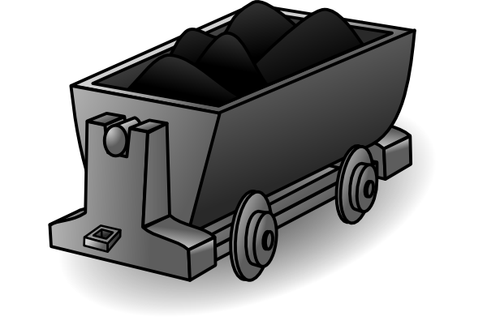
J. Examples of BIG BUSINESS:
RAILROADS | OIL | STEEL | COAL

Slide 16
Post-Civil War…
K. Changes in Farm & City Life
1. MECHANIZATION Reduced manual labor needs on the farm and INCREASED production
Ex. The Reaper

Slide 17
Post-Civil War…
K. Changes in Farm & City Life
2. INDUSTRIAL development in cities created increased LABOR needs
People left their jobs on farms to live in the city and work in factories
Immigrants also worked in factories to meet the labor demand

Slide 18
Post-Civil War…
K. Changes in Farm & City Life
3. INDUSTRIALIZATION provided new access to CONSUMER goods
Ex. Mail Order

Slide 19
now…back to the Captains of Industry

Slide 20
Rockefeller Net Worth:
1st American to have a net worth over 1 billion…
1918 = 1.5 billion
2017 = 341 billion
His wealth equaled 2% of total U.S. economic output.
He also had the habit of giving a Dime to every person he met.

Slide 21
Carnegie Net Worth:
Tricky because he began donating all of his wealth before his death…
In 1901, J.P. Morgan & other investors bought Carnegie Steel Company for $480 million, with $230 million going straight to Carnegie himself.
2017 = 310 billion

Slide 22
Vanderbilt Net Worth:
2017 = 185 billion
Then his son, William Henry Vanderbilt took over the family business in 1877 and DOUBLED his father’s fortune.
“You have undertaken to cheat me. I won't sue you, for the law is too slow. I'll ruin you.”
- Cornelius Vanderbilt

Slide 23
Henry Ford Net Worth:
2017 =199 billion
Ford’s use of assembly line production in his factories reduced the cost of cars and turned the Model T into the “Car for Every American!”
How much did it cost to purchase a Model T?
1910 = $900
1915 = $390
1925 = $260
“Any customer can have a car painted any color that he wants so long as it is black.”
― Henry Ford

Slide 24
J.P. Morgan Net Worth:
As a banker, Morgan was known to invest in & purchase of variety of companies…in a variety of industries. At one point he was the financial supporter of Nikola Tesla, only to later become the financial backer of Tesla’s competition...Thomas Edison & General Electric.
1913 = 68.3 million
2017 = 1.4 billion
After Morgan’s death, upon learning the value of Morgan’s estate, Andrew Carnegie commented, “And to think, he wasn’t even a wealthy man.”

Slide 25
A TRUST is a…
Business or corporation that has significant control of an industry
Multiple companies within the same industry can form a trust to control prices and regulate the supply of a product
Preventing competition in the marketplace
Trust is a term closely associated with “monopoly.”

Slide 26
SHERMAN ANTITRUST ACT, 1890 – A law passed to protect free trade and take power away from the monopolies:
Prevent unfair business practices
Stop powerful corporations from setting high prices
Create a balance of power that allows equal opportunities for all businesses
Prohibit anti-competitive practices
Allow new competition to enter the market
One of the other main goals of the Sherman Antitrust Act.... to reduce the power of Captains of Industry…
aka…“Robber Barons”

Slide 27
How the U.S. Government Accidently Made Rockefeller the RICHEST AMERICAN EVER…

