Slide 1
Case Study
U.S. Industrial Cities

Slide 2
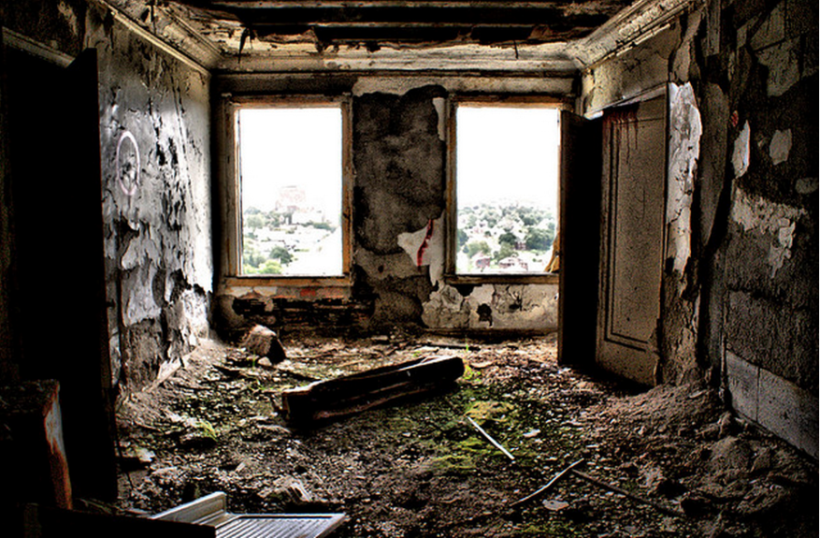
What do you think happened here?

Slide 3
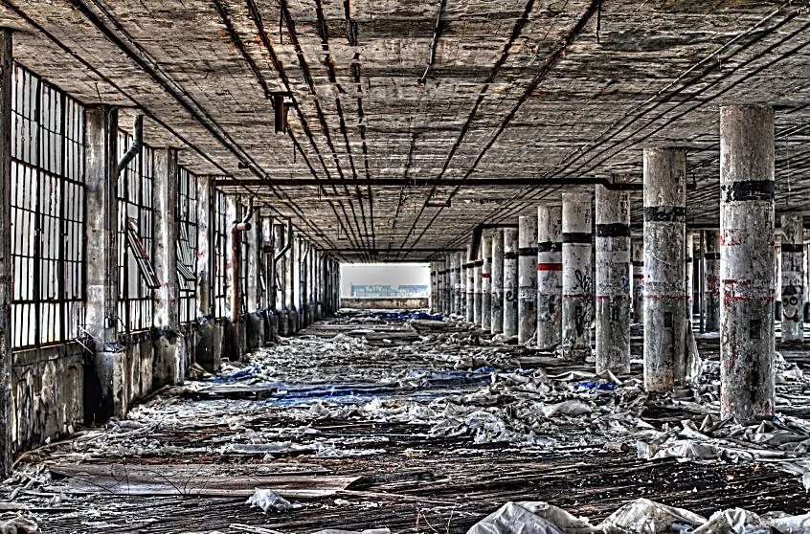
What do you think happened here?
http://www.stillscenes.com/among-the-ruins-of-the-detroit-packard-plant/

Slide 4
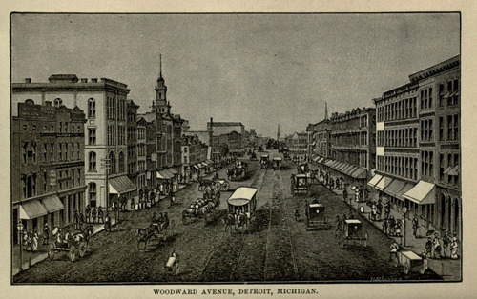
A Case Study of
an American City
DETROIT
Then & Now

Slide 5
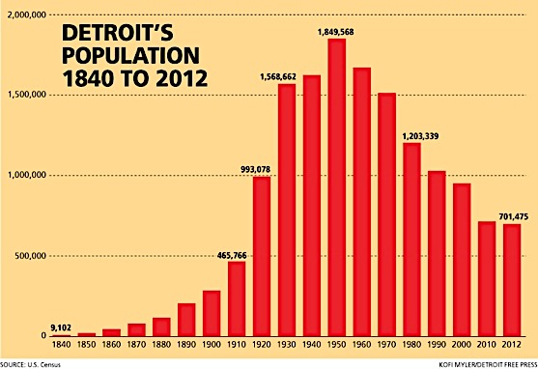
Wall Street Journal Graph – Click Here

Slide 6
Let’s take a look at Detroit….

Slide 7
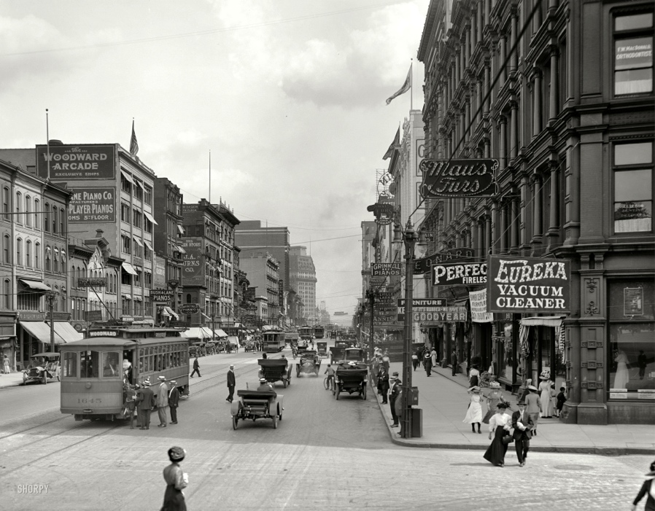

Slide 8
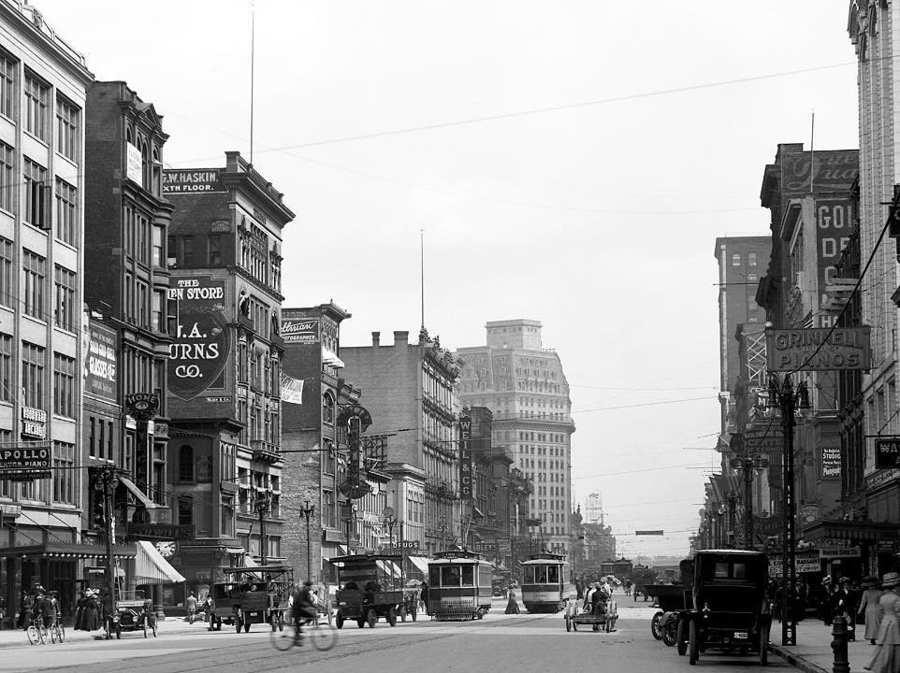

Slide 9
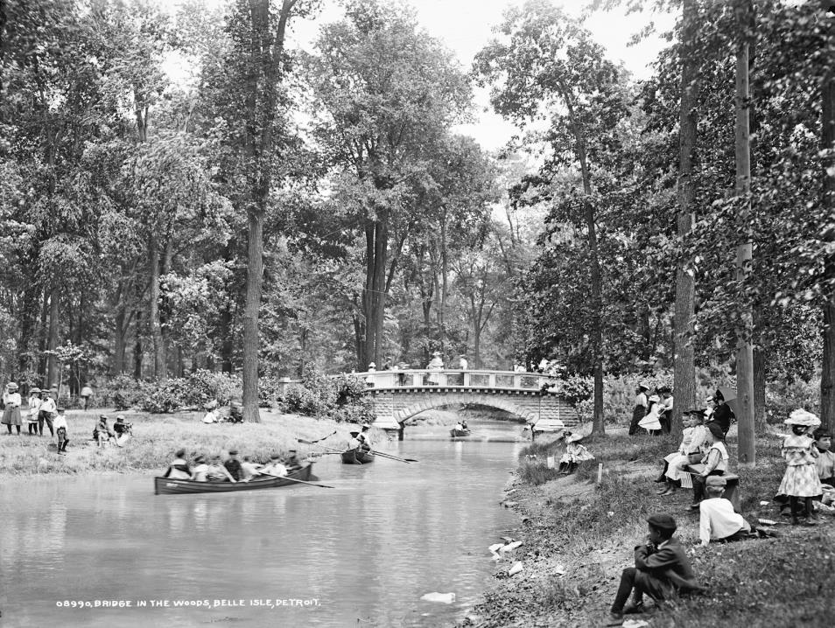

Slide 10
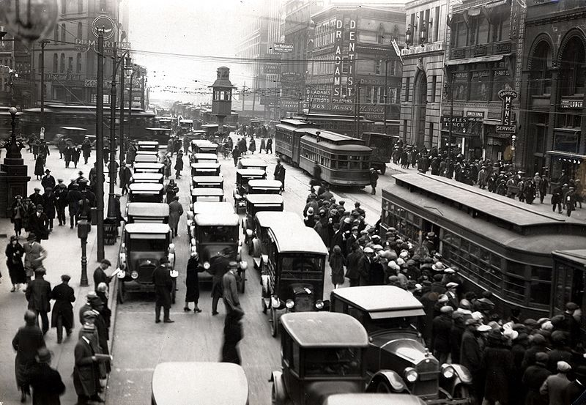

Slide 11
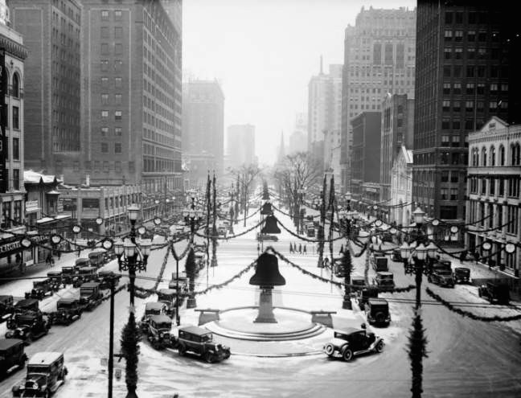

Slide 12
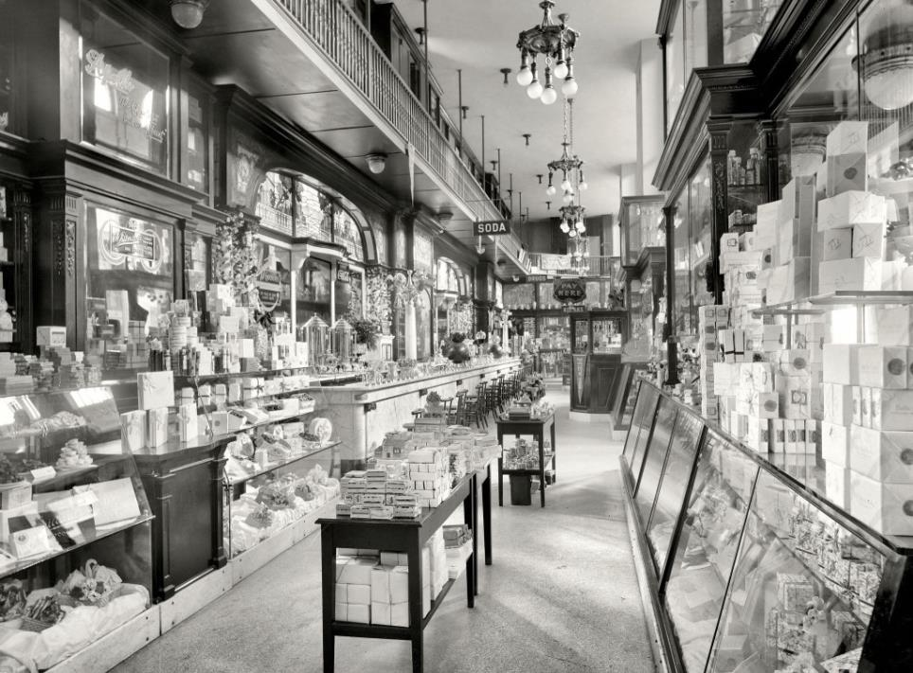

Slide 13
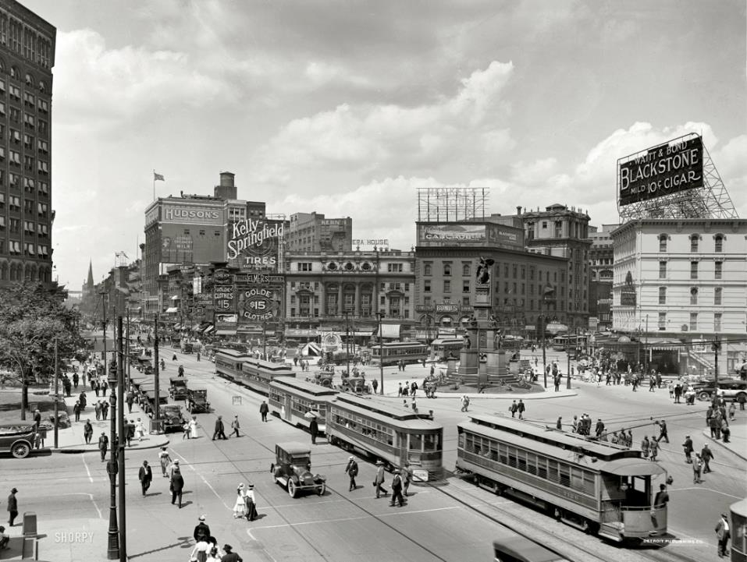

Slide 14
Detroit
In Ruins

Slide 15
United Artists Theater
150 Bagley Street, Detroit, MI
Built 1928

Slide 16
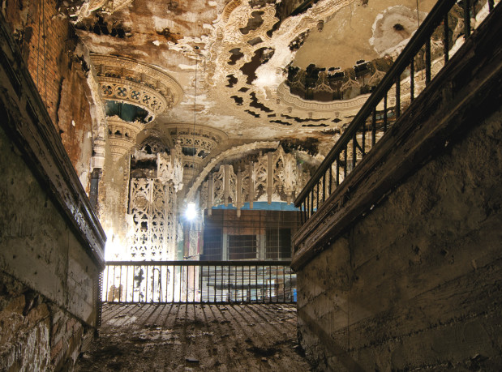
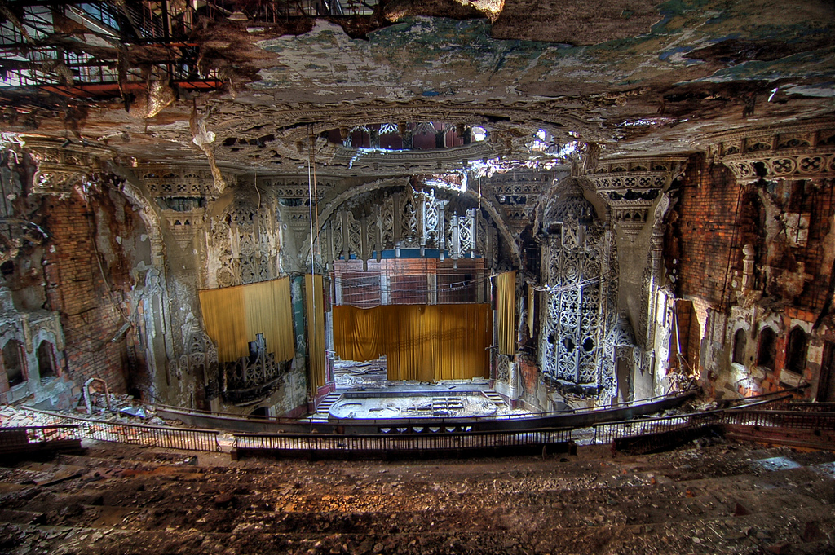
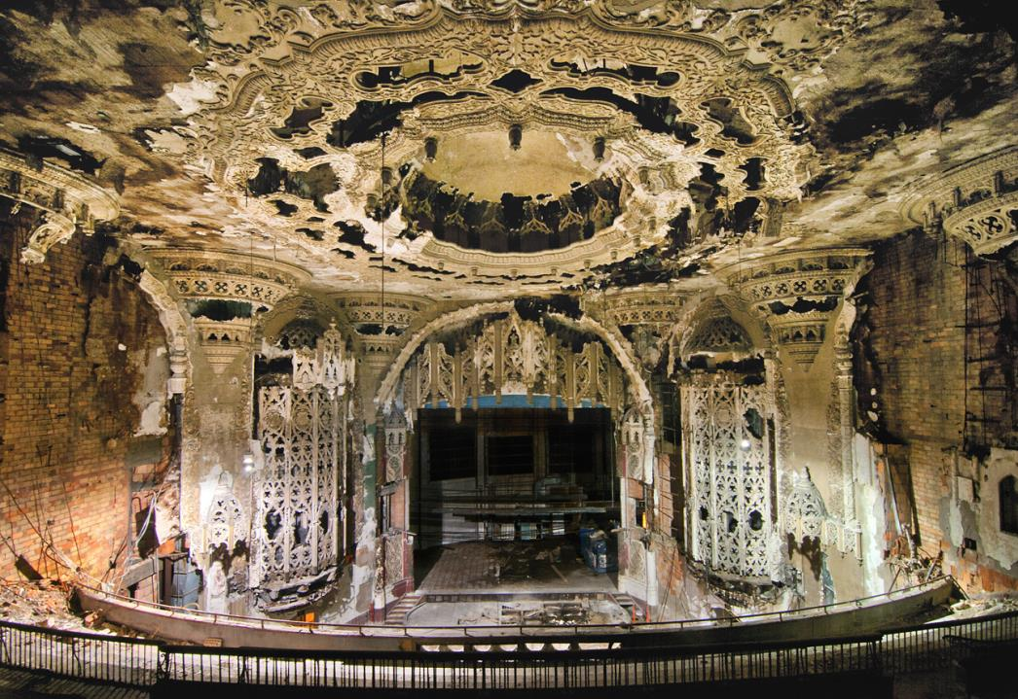
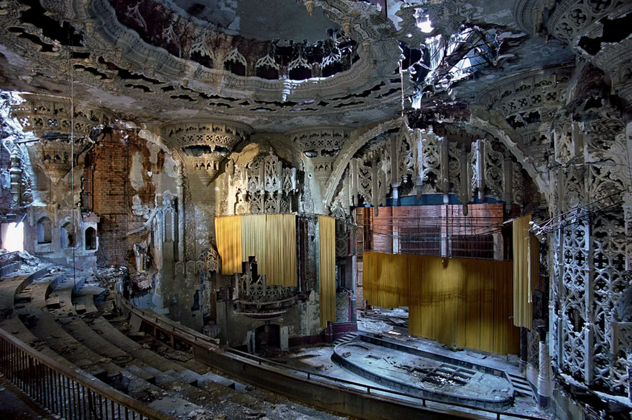
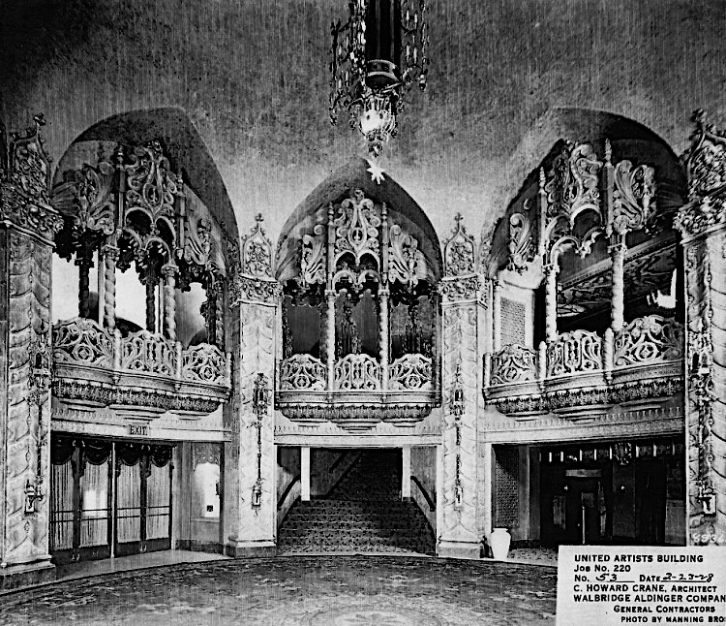
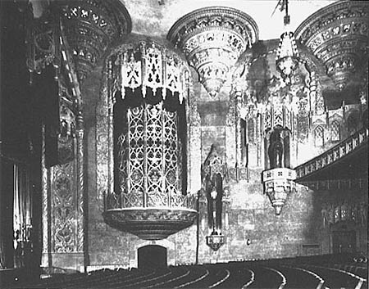
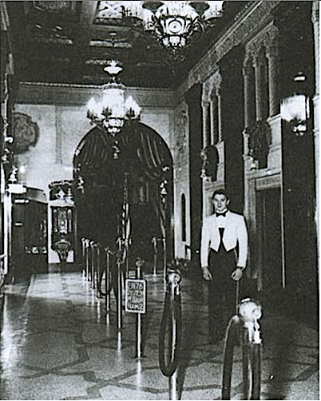
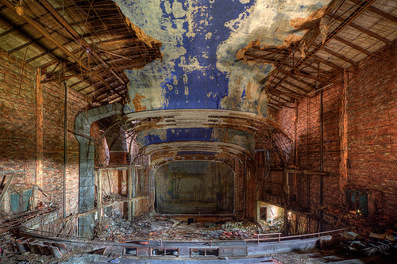
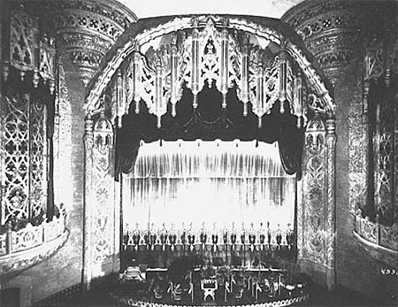

Slide 17
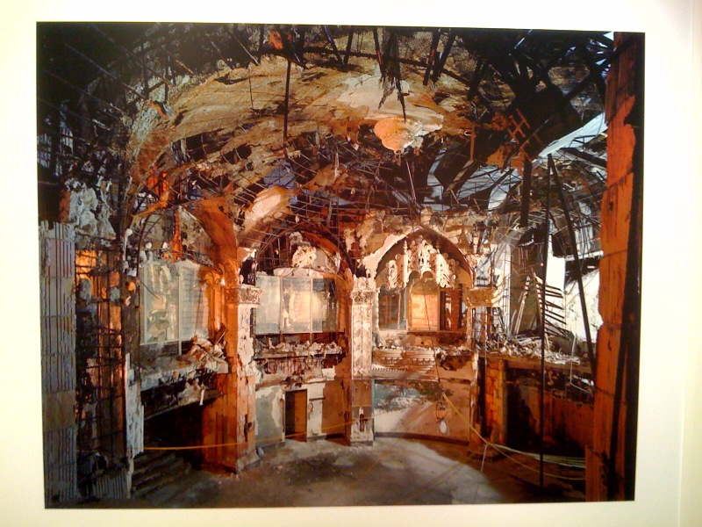
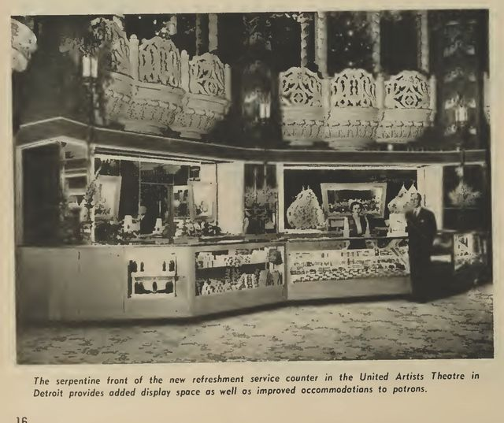

Slide 18
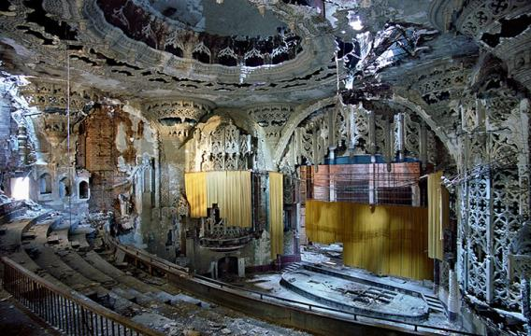
SEE MORE:
United
Artists
Theater

Slide 19
Michigan Theater
220 Bagley Street, Detroit, MI
Built 1926
Closed 1976

Slide 20
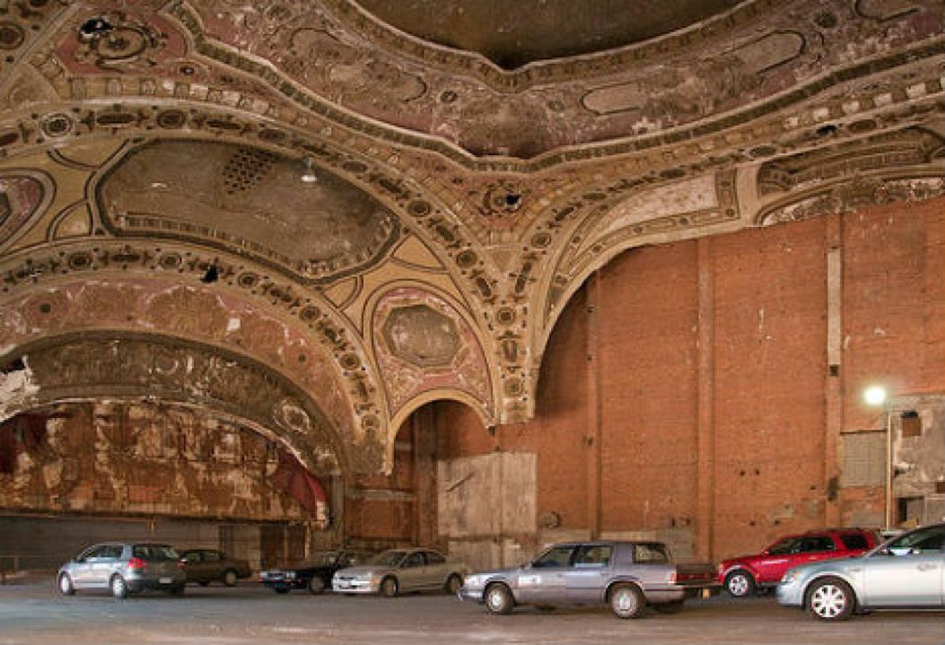
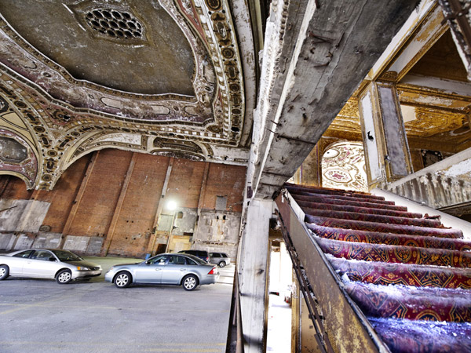
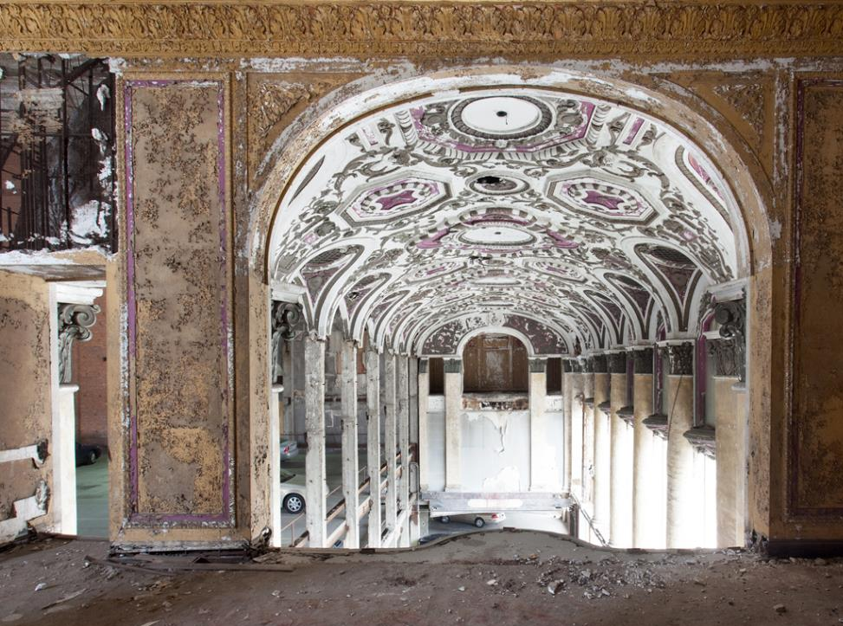
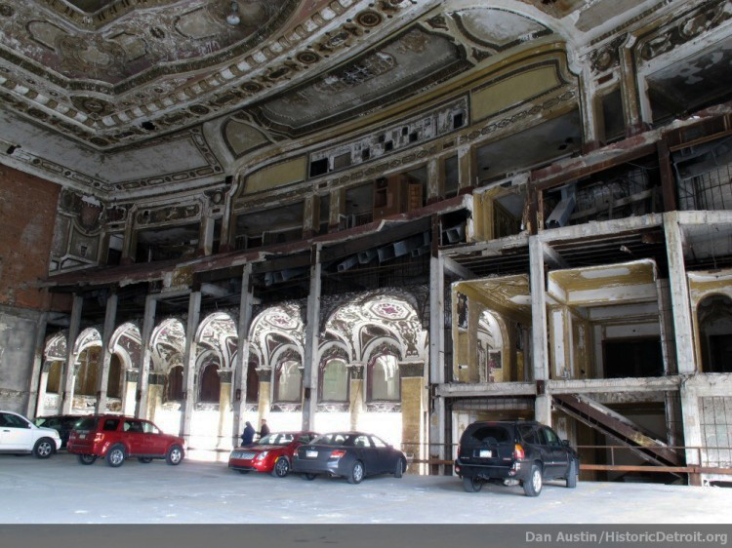
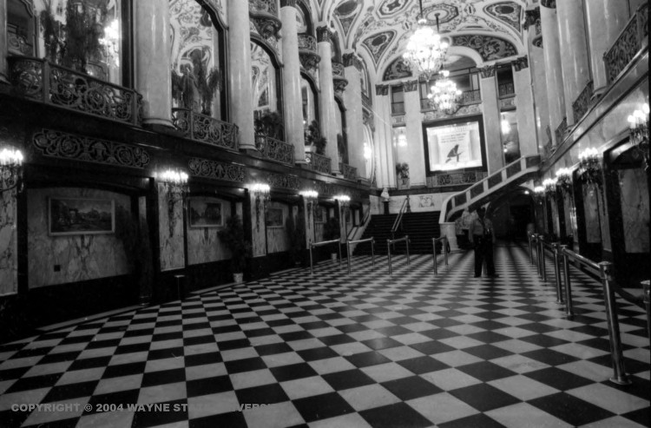
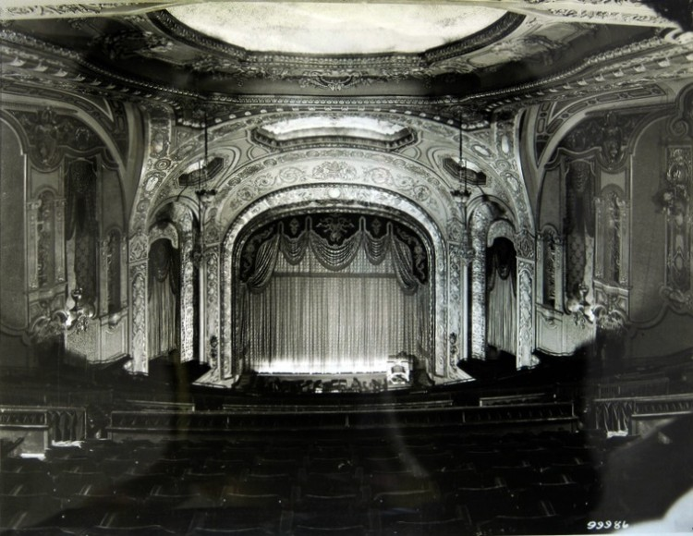
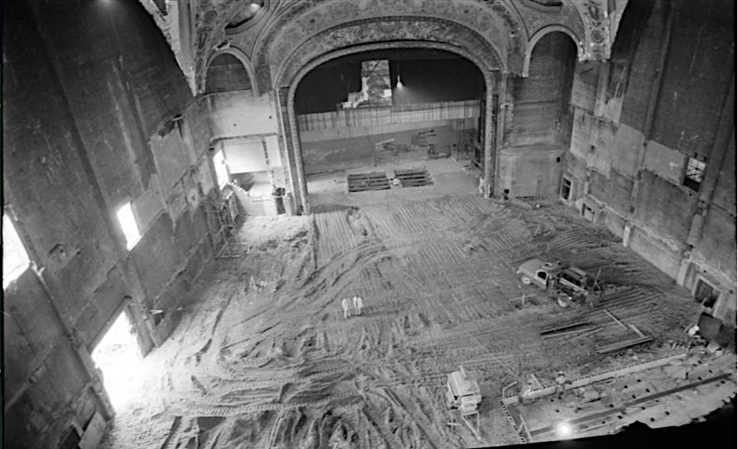
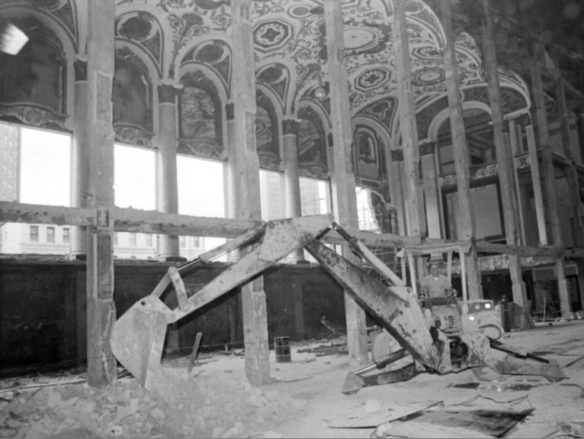
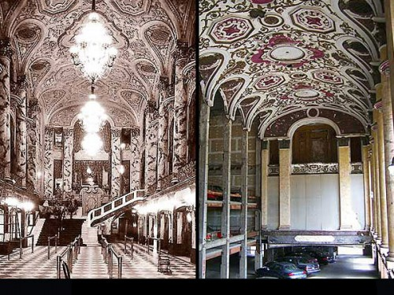
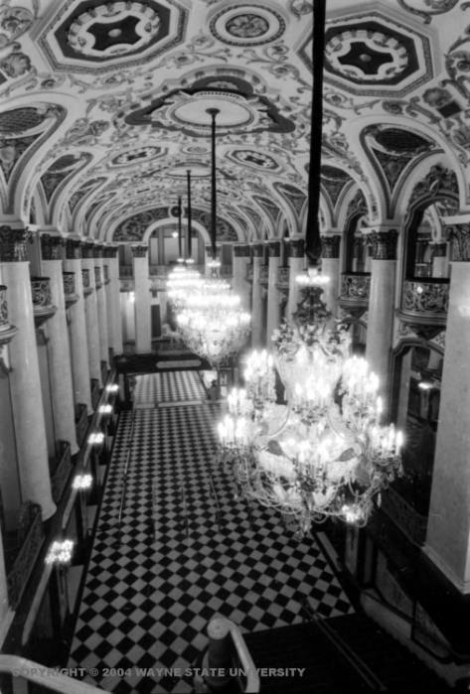
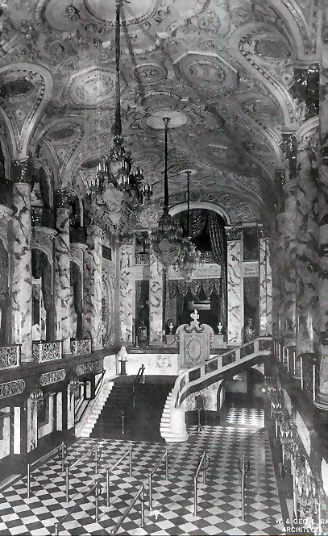

Slide 21
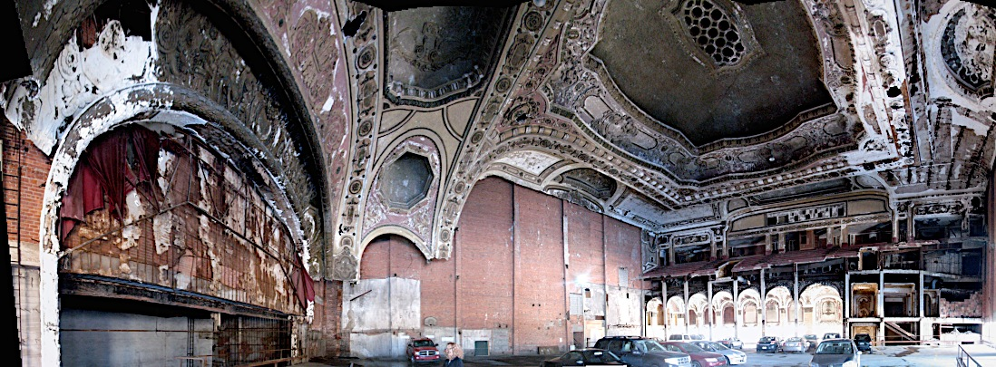
Michigan Theater
SEE MORE:

Slide 22
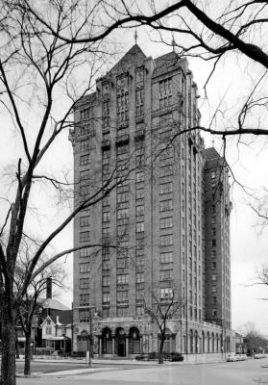
Lee Plaza Hotel
2240 West Grand Boulevard, Detroit, MI
Built 1929

Slide 23
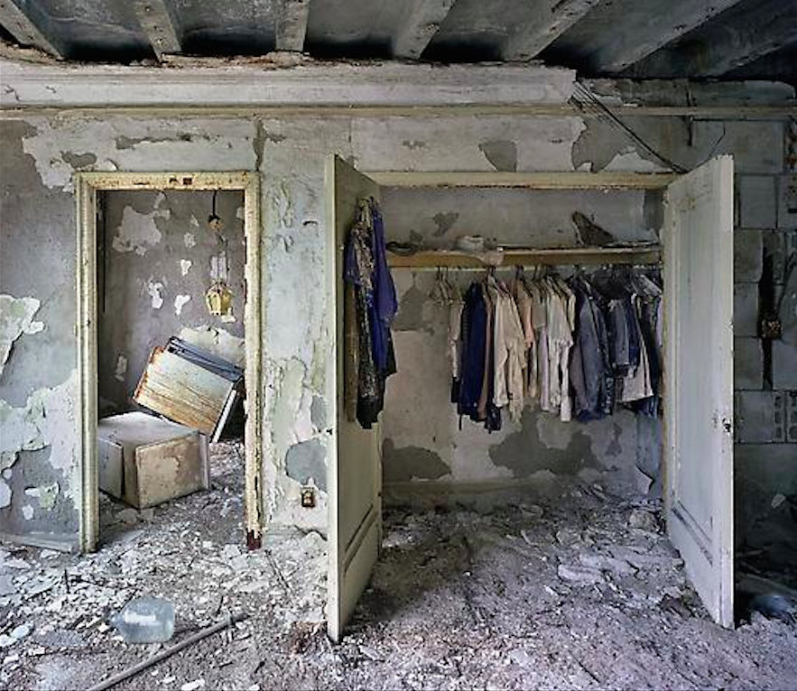
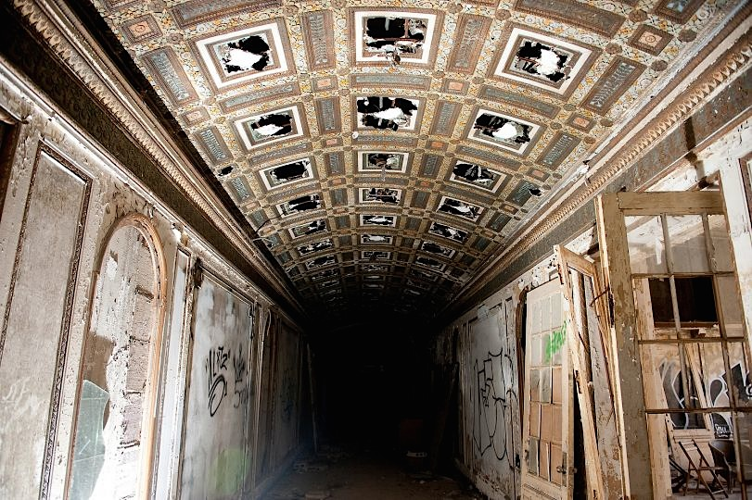
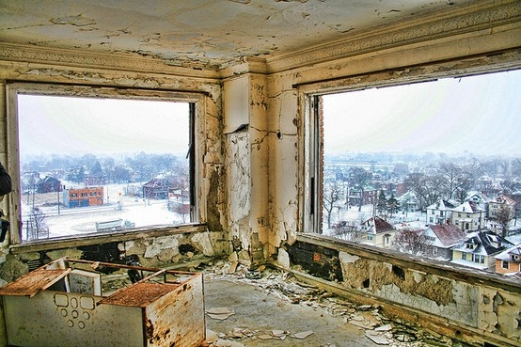
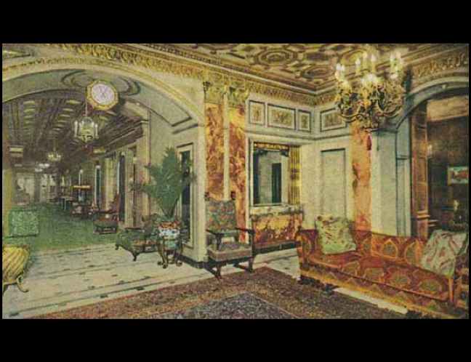
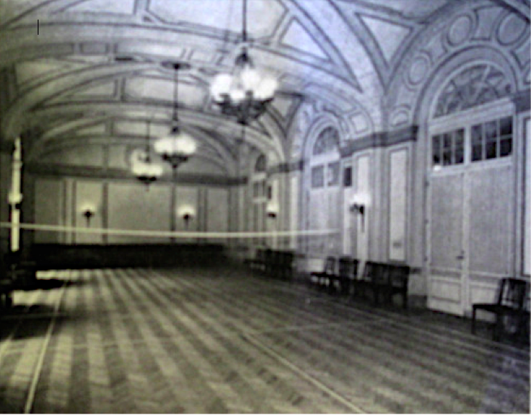
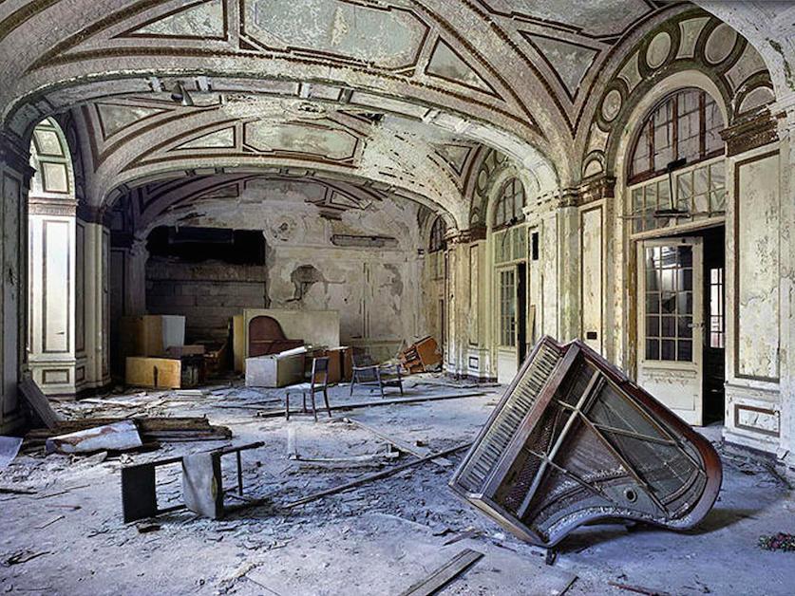
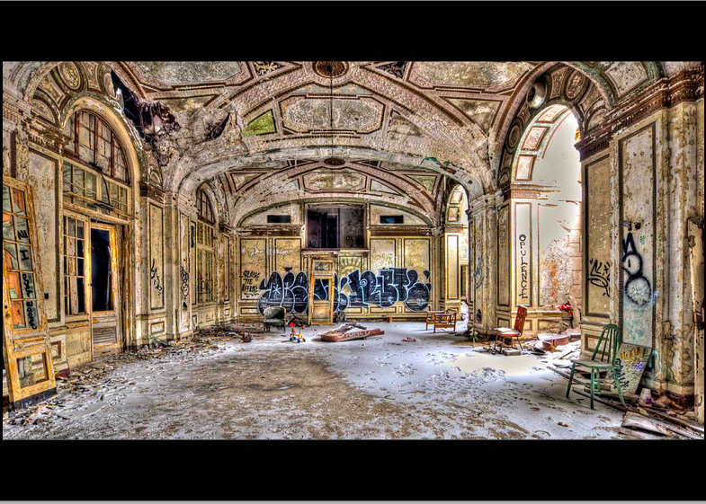
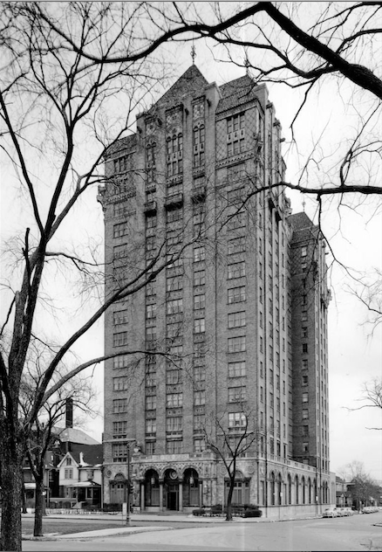

Slide 24
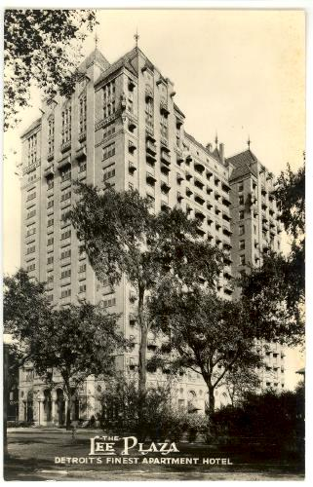
SEE MORE:
Lee Plaza Hotel
2240 West Grand Boulevard
http://bit.ly/1NEkIQx

Slide 25
Michigan Central Station
2405 West Vernor Highway, Detroit, MI
Built 1913

Slide 26
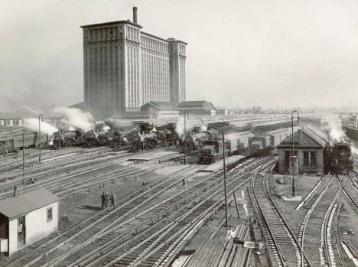
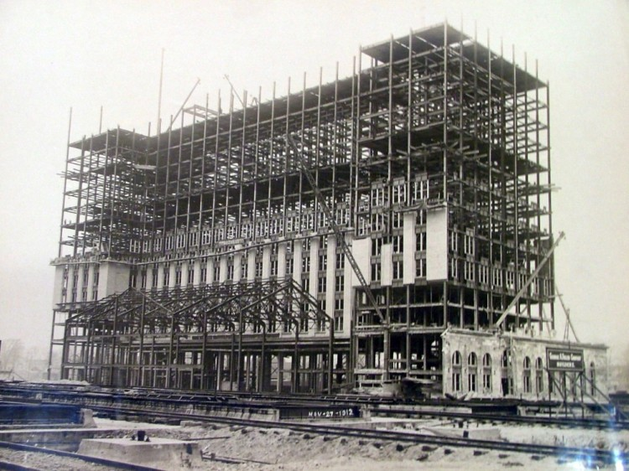
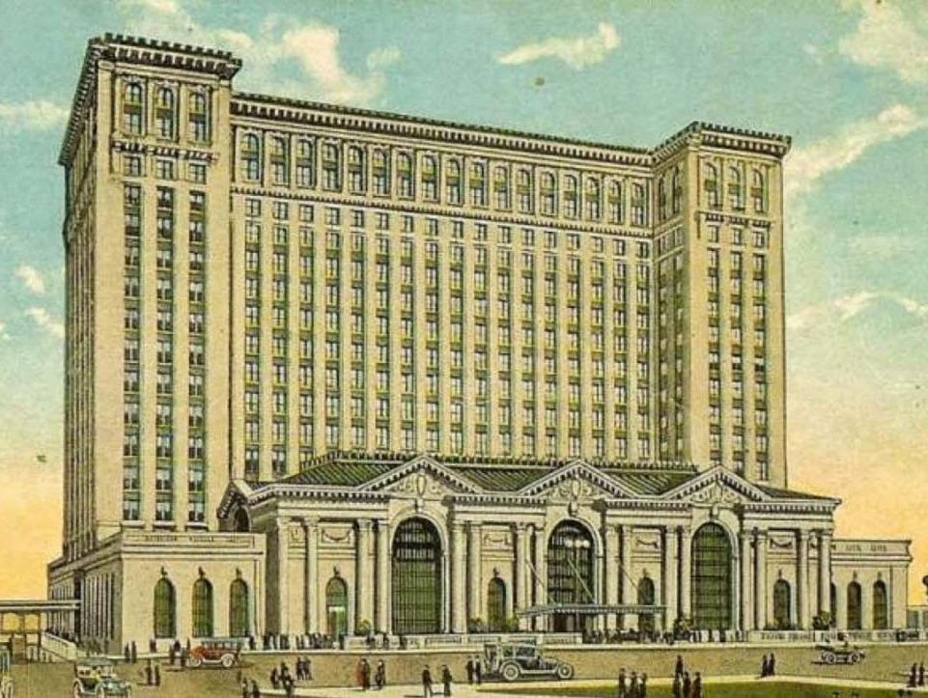
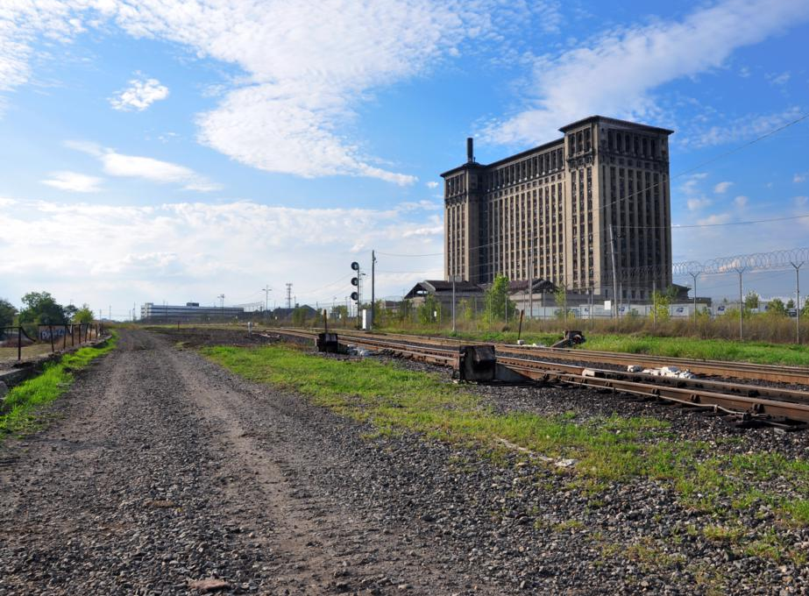

Slide 27
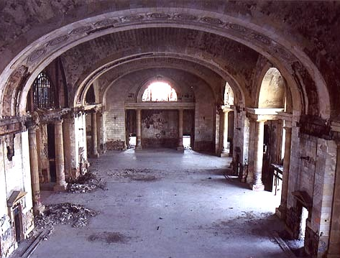

Slide 31
Michigan’s Central Station
train station
SEE MORE:

Slide 32
See how Detroit’s Grand Central Station is being transformed…

Slide 33
Brush Park, Detroit, Michigan
Gilded Age Mansions
Detroit, MI

Slide 37
Ransom Gillis House:
HGTV Rehab Addict

Slide 38
HGTV
Brush Park & the Gilded Age Mansions of Detroit
Historic Detroit: Gallery of Homes
PHOTOS: Ruins of Brush Park
News: “Redevelopment of Brush Park”

Slide 39
1958

Slide 40
Brush Park
Sept. 2017 View
Brush Park: A Visual History
http://bit.ly/1NEmvFr

Slide 42
Redevelopment of Brush Park

Slide 43
Belle Isle
Opened 1845

Slide 45
Belle Island Nature Zoo

Slide 46
The Packard Plant
Opened 1903
Closed 1958

Slide 53
The Packard Plant: TODAY

Slide 58
The Packard Plant
Then & Now:
Interactive Photos

Slide 59
See drone footage of the Packard Plant in April, 2018…

Slide 60
Photos from
“The Ruins of Detroit”
by Yves Marchand
& Romain Meffre
Source: http://www.marchandmeffre.com/detroit

Slide 70
SCHOOLS:
Cass Technical High School
David Mackenzie High School
Redford High School
CHURCHES:
Woodward Avenue Presbyterian Church

Slide 71
Go Back to your pods….
It’s time to tell your teacher how could this happen?
Quick Transition...3 minutes

Slide 72
DIRECTIONS: As a pod, discuss the images you saw. Brainstorm reasons for the downfall of Detroit, Michigan. Be prepared to discuss your reasons with the class.
What events in U.S. history contributed to the downfall of Detroit, a city that went from the “Paris of the West” to a city in ruins in less than a century?

Slide 73
Think about this….
Population of Chicago (2014) = 2,722,389
Population of NYC (2014) = 19,746,227
Population of Philadelphia (2014) = 1,560,297
Population of Los Angeles (2014) = 10,116,705
Population of San Antonio (2013) = 1,436,697

Slide 74
Source: Wall Street Journal - http://on.wsj.com/1KuRiO7

Slide 78
CNN Money
Detroit Files for Bankruptcy
Los Angeles Times:
“Out of Money, Detroit Calls it Quits”

Slide 79
Want to see more
“Then & Now” Pictures?
Click Here…
Washington Post:
Detroit’s Half Century of Decline

Slide 80
Main Sources:
Photo Galleries
Forgotten Detroit – Photo Galleries
Photo Galleries

Slide 81
But wait… it’s not just Detroit!
Cleveland, OH

Slide 87
One of John D. Rockefeller’s
Cleveland Homes….
…Forrest Hill Estate

Slide 88
Rockefeller’s 2nd Home…Euclid Ave.

Slide 91
Millionaire’s Row…Euclid Ave, Cleveland, Ohio
…including homes of John D. Rockefeller, founder of Standard Oil Co.
“Echoes of a Grand Age: Cleveland’s Vanished Euclid Avenue”

Slide 92
Google Earth:
Let’s see what Millionaire’s Row looks like now.

