Slide 1
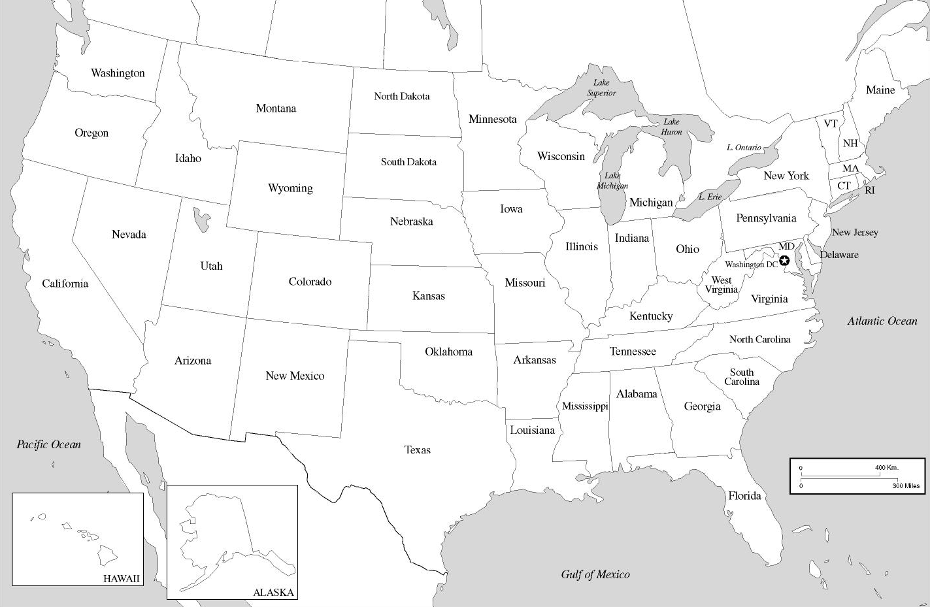

Slide 2
Slide 1: List of Cities
Slide 2: Blank Map to Label
Question:
How did these 19 cities contribute to the economic, political, and cultural growth of the United States?

